Slide 1
Thomas Scholbach - Leipzig - Practice for functional ultrasound - www.scholbach.de
Unraveling the conundrum of female pelvic pain by tissue perfusion measurement of pelvic organs

Slide 2
Conflict of interest:
Prof. Dr. med. habil. Thomas Scholbach together with his son ,
Prof. Dr. rer. nat. habil. Jakob Scholbach created the PixelFlux technique and
4D-PixelFlux volume flow measurement technique.
His son is the owner of the company Chameleon Software.

Slide 3
Pelvic pain – Pelvic congestion syndrome
Patients
  774 female patients encompassing 90% of all patients including in addition male and transgender persons
  with chronic pelvic pain examined from 01/2023 to 06/2026
Methods
  1. Tissue perfusion measurement of pelvic organs with the PixelFlux-Technique
  2. conventional Doppler ultrasound blood flow volume measurement of both internal iliac veins
  3. pressure gradient measurement of venous compressions

Slide 4
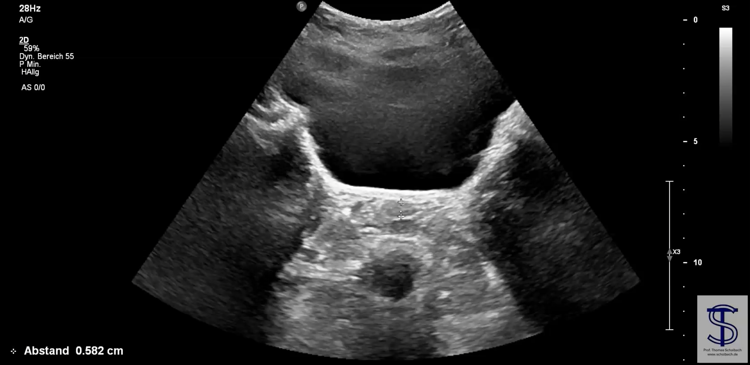
Pelvic congestion – quantified with PixelFlux
Congestion – more blood travels retardedly across pelvic organs
Pixelwise quantification allows precise diagnosis
  Uterus
  Vagina
  Urethra
  Rectum
  Ovaries

Slide 5
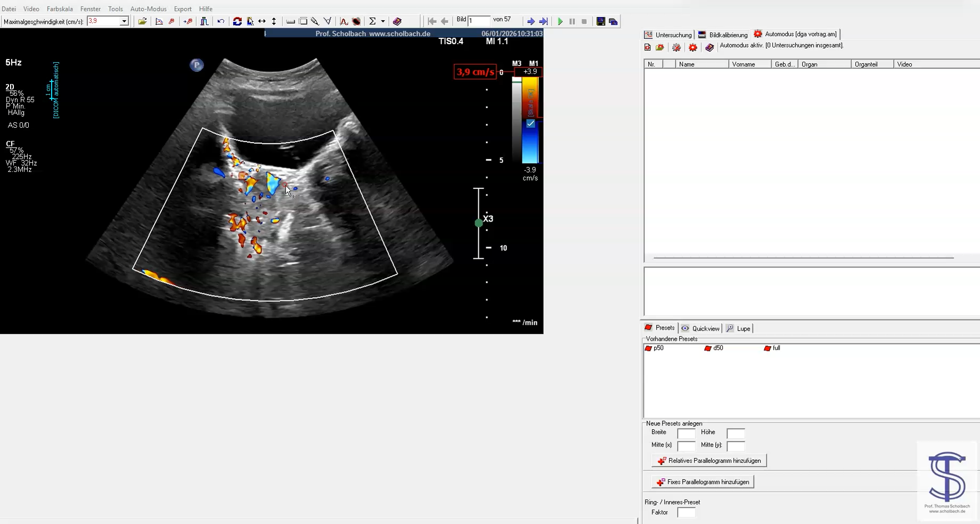
PixelFlux tissue flow measurement

Slide 6
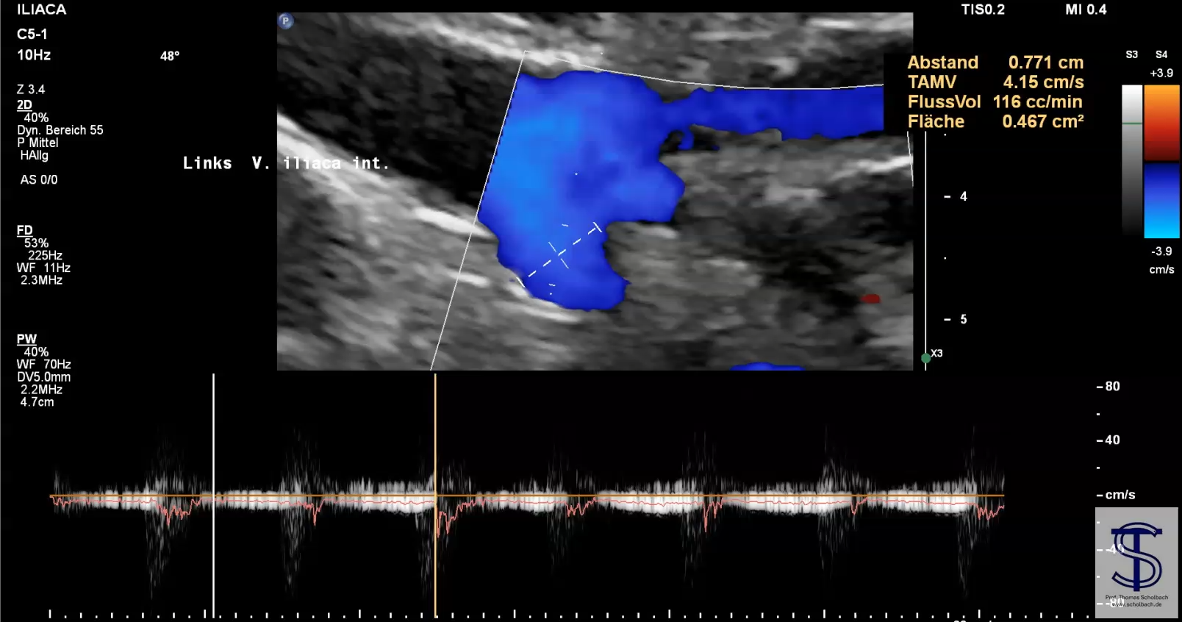
Cause of pelvic congestion
Hampered outflow
  Left common iliac vein
  Right common iliac vein
  Vena cava inferior
Increased influx
  Left renal – left ovarian vein

Slide 7
Sequelae of PCS and their diagnosis
Congestion of
  Legs
    Check femorals &popliteals
  Pelvis
    Micturition, defecation, sexual intercourse
    First left then right sided symptoms
  Sciatic nerve
    Inferior gluteal vein
  Spine
    4D-PixelFlux
    Tronc rénorachidèn
    Asc. Lumbar vein
    Sacral vein
    Hemiazygos vein
  Gluteals
    Sup& inf. gluteal vein
  Pudendal nerve territory
    Internal pudendal vein
    PixelFlux external genitalia

Slide 8
Female chronic pelvic pain may be PCS
Any chronic pelvic or genital pain is a potential sign of PCS
Confirm the congestion
  Standardized PixelFlux flow measurement – Diagnosis established
  Flow volume comparison of both internal iliac veins
Find and quantify the outflow obstruction
  Left / right common iliac vein
  Vena cava inferior
Find the increased influx
  Left renal vein compression – PixelFlux of both kidneys
  Left ovarian vein flow volume
Find and differentiate volume flow in collaterals
  ascending lumbar – sacral – hemiazygos– Retzius-collaterals – superior mesenteric
Restore the normal pathways:
  no coiling, no hysterectomy, no obliteration, no stents
  Reduce lumbar lordosis, facilitate collaterals, PTFE enveloping of compressed venous segments

