Slide 1
Understanding of simultaneously occurring vascular compression syndromes may be a gate
to gender-equal vascular medicine
Thomas Scholbach - Leipzig - Practice for functional ultrasound - www.scholbach.de

Slide 2
Conflict of interest:
Prof. Dr. med. habil. Thomas Scholbach together with his son ,
Prof. Dr. rer. nat. habil. Jakob Scholbach created the PixelFlux technique and
4D-PixelFlux volume flow measurement technique.
His son is the owner of the company Chameleon Software.

Slide 3
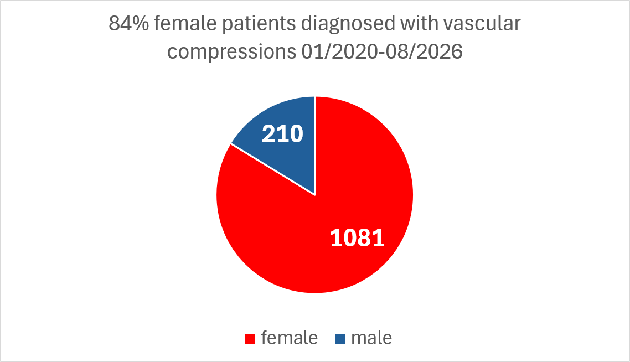
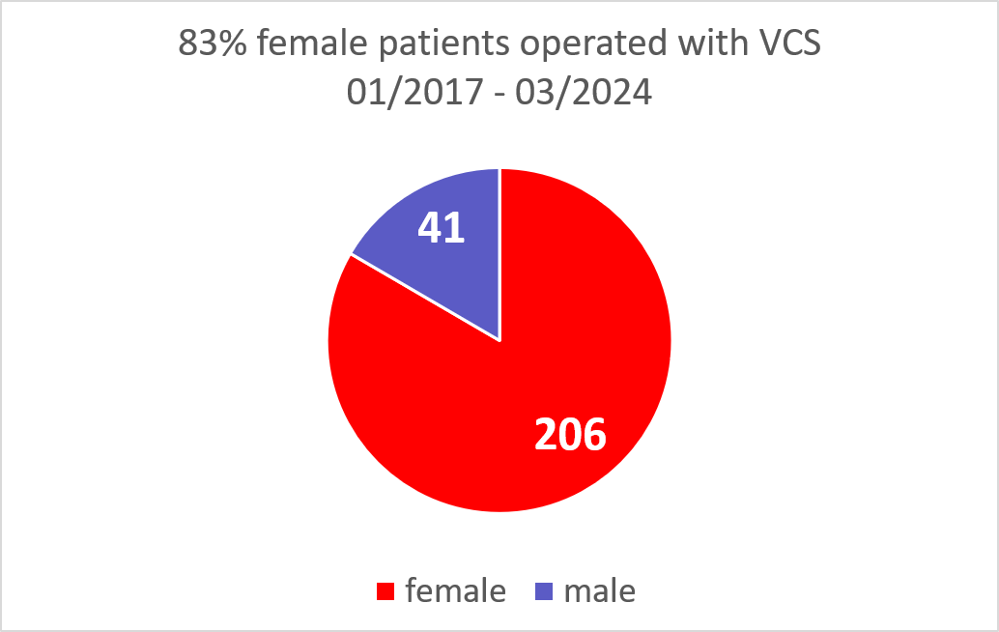
Vascular compressions – a female domain

Slide 4
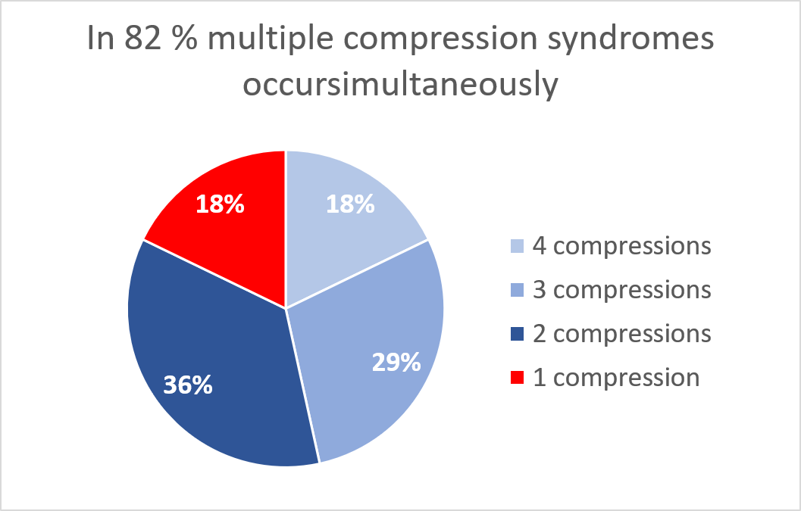
Multiple compressions are the rule, not the exception

Slide 5
Increased lumbar lordosis and soft connective tissue – a typically female combination
operated patients | number | percentage
Patients total | 247
Female patients | 206 | 83%
Male patients | 41
Patients with EDS | 174 | 70%
Female patients with EDS | 150 | 86%
Male patients with EDS | 24 | 14%
V L Murri et al Clin Anat. 2003 Mar;16(2):144-7„.. lumbar lordosis is more prominent in women
(P < 0.01)..“
J F Baile et al. J. Anat. (2016) 229, pp82—91 „that females have greater lumbar lordosis than males when standing, but not when supine“
R Rajabi et al. Asian Spine J. 2024;18(6): 836-845 „Lumbar lordosis curvature was generally higher by 7.5° in women than in men.“

Slide 6
Women have flatter thoraces
D García‐Martínez et al. American Journal of Physical Anthropology 1161(3): 467-477 (2016)„Male rib cages were wider (particularly caudally) and shorter, with more horizontally oriented ribs when compared to females.“
X Shi et al. Journal of Biomechanics 18 July 2014; 2277-2285 - Observed that men generally sustained a greater rib cage volume and greater rib cross-sectional area than women with the same stature.
M Romei et al. Respiratory Physiology & Neurobiology, 31 July 2010; 184-191- Showed that the total dimension of the chest wall was generally higher in males than in females, primarily due to the rib cage being characterized by longer anterior-posterior diameters, perimeter, and larger cross-sectional area and volume in males.

Slide 7
Women have a shallower pelvic inlet
B Fischer et al. The Anatomical Record 300:698–705 (2017)- Reported that females generally possess a relatively flatter and wider pelvis compared to males.
P Kotak et al. International Journal of Legal Medicine; 30 March 2026 Volume 140, pages 2363–2370 - Reports that males exhibited significantly greater iliac height—a vertical dimension measurement—compared to females (199.19 mm vs. 186.27 mm) in the studied population.

Slide 8
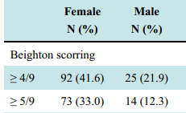
Women have more stretchy connective tissue
L Remvig et al. The Journal of Rheumatology April 2007, 34 (4) 804-809; - the condition of having loose joints or lax connective tissue is more common in women.
NS Chidi-Ogbolu Front. Physiol., 15 January 2019, Sec. Exercise Physiology, Volume 9 – 2018 - .. knee laxity increases in women during the ovulatory phase of the menstrual cycle in direct relation to elevations in plasma estradiol levels.
F Tuna, The European Research Journal 2020;6(2):120-129: healthy students

Slide 9
Midline syndrome contains it all
Compression in the midline
  Spine – increased curvature – flat abdominal cavity – blocked prespinal veins and intestines veins
    Left renal , left common iliac, left brachiocephalic, portal, superior mesenteric, splenic vein, inferior vena cava
    Duodenum, stomach, ileum,
Congestion at the midline
  brain, vena cava, uterus (prostate), vagina, urethra, rectum, external genitalia, legs
Exaggerated while upright
  POTS, dizziness, pelvic pain, leg pain, nephroptotic perfusion loss, increased spinal compression

Slide 10
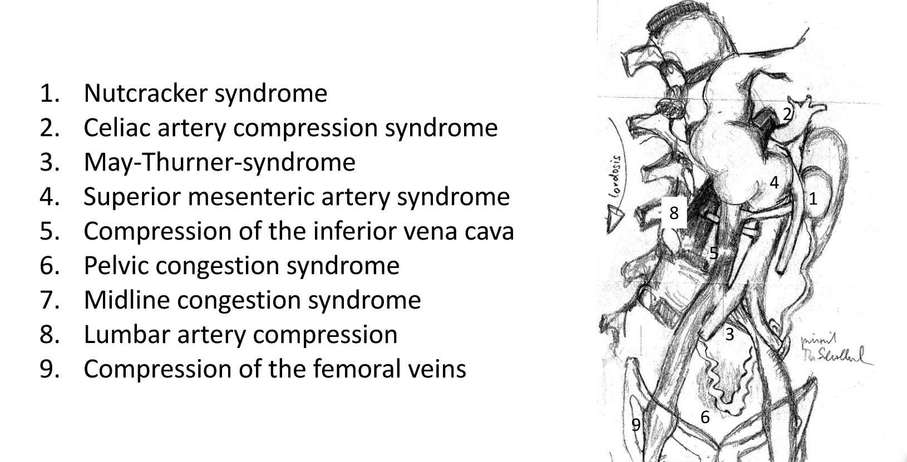
Midline syndrome contains it all

Slide 11
How to evaluate potential VSC-patients?
4D-PIXELFLUX global cerebral perfusion measurement at different head positions
(Post)prandial assessment of the upper abdominal vessels and renal perfusion
Repetition of measurements in an upright standing position
Measurement of orthostatic renal ptosis and its correlation with renal perfusion
Measurement of the influence of diaphragmatic position on flow in the celiac trunk and vena cava at the level of the diaphragm
(Post)prandial assessment of gastric and duodenal peristalsis and compression
Comparison of flow volumes in the mesenteric vein and iliac vein before and after a meal / micturition
Assessment of subclavian vein flow to rule out thoracic outlet syndrome
Standardised medical history taking using a quantitative, holistic questionnaire
Symptom-centred venous colour-duplex ultrasound from the extremities to the heart, including cervical and (intra)cranial vessels
Measurement of diameter and flow velocity at sites of compression
Measurement of blood flow volume in affected vessels
Quantitative tissue perfusion measurement of all pelvic organs
Layer-by-layer renal parenchymal perfusion measurement
Aortic blood flow measurement in the supine and standing positions

Slide 12
Diagnostic algorithm of vascular compressions think globally not locally vessels form circles - no dead end streets
Volume flow comparison
Tissue perfusion - side comparison
Symptom correlation
Venous diameter reduction
Pressure gradient
Diagnosis
Pelvic organ congestion
Functional (volume) flow
PixelFlux
  Vagina
  Uterus
  Urethra
  Rectum
4D-PixelFlux
  CCA, IJV
  VA, VV
  Epidural Plexus
Left/right internal iliac vein
Asc. lumbar vein
Lumbar vein
Hemiazygos
Azygos
Sup./inf. Gluteal
Aorta
SMA + SMV
Fem A +V
Left common iliac vein
Left renal vein
Vena cava inferior
Sup. Mes. Vein
Splenic vein
Portal vein
Celiac trunk
Sup. Mes. Artery
Internal jugular veins
Left common iliac vein
Left renal vein
Vena cava inferior
Sup. Mes. Vein
Splenic vein
Portal vein
Celiac trunk
Sup. Mes. Artery
Lying
Sitting
Standing
Preprandial
Postprandial
After exercise
Inspiration
Exspiration
Provocative manoeuvres
PixelFlux
3 renal layers
GI-tract
200 items questionnaire
Software evaluation

Slide 13
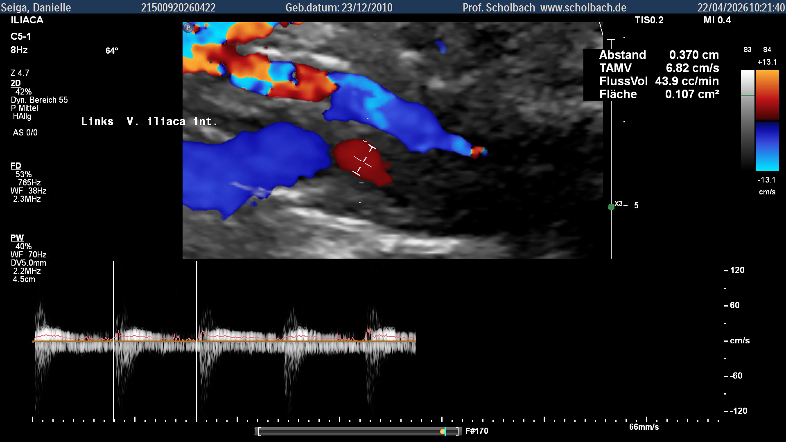
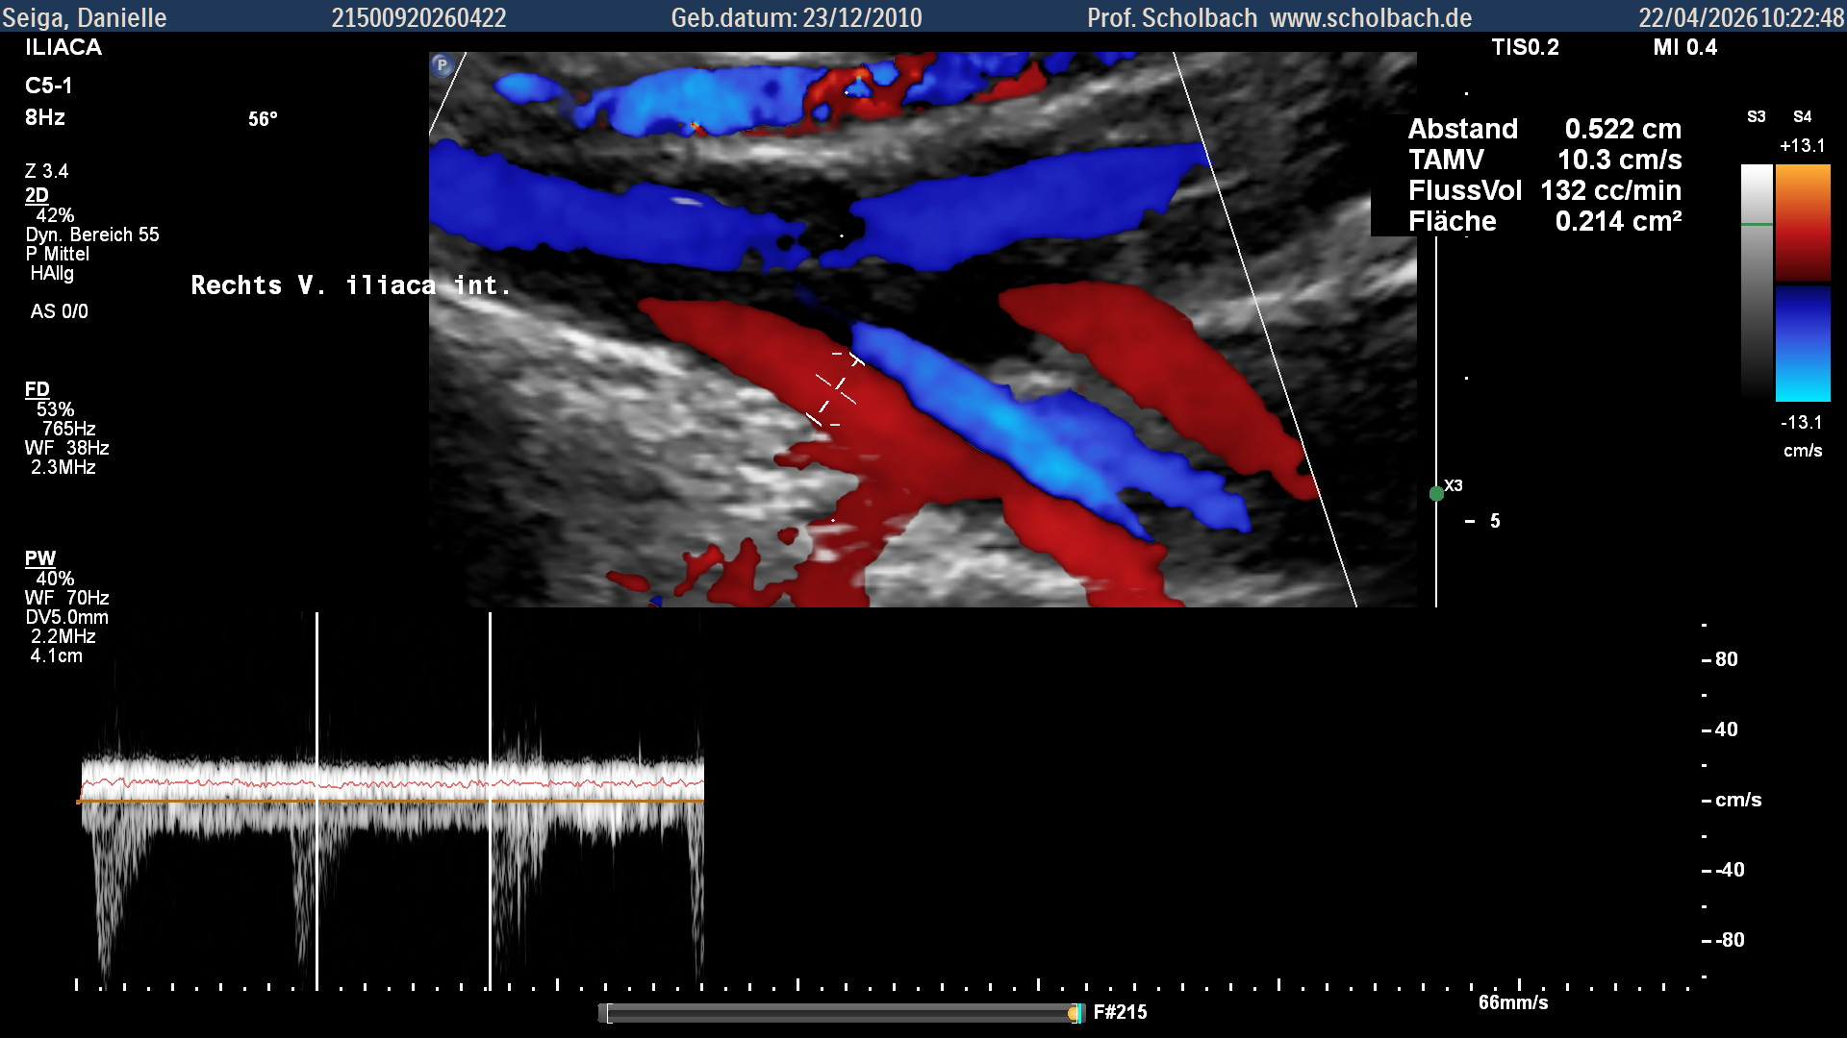
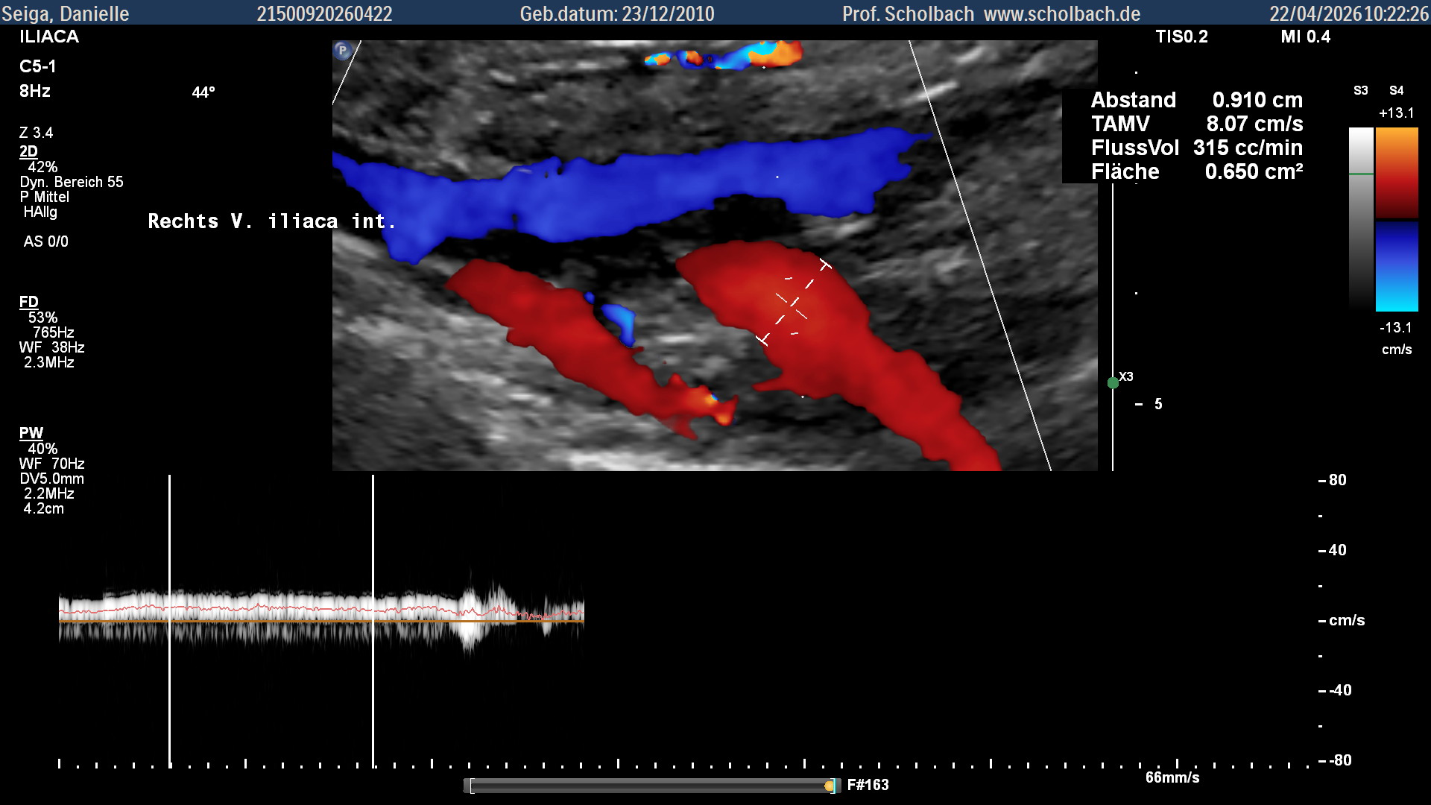
Internal iliac venous flow imbalance
Single left iiv
Ratio left/ right internal iliac venous flow volume
44 /(315+132)= 10% - instead of 50%
Right 1
Right 2

Slide 14
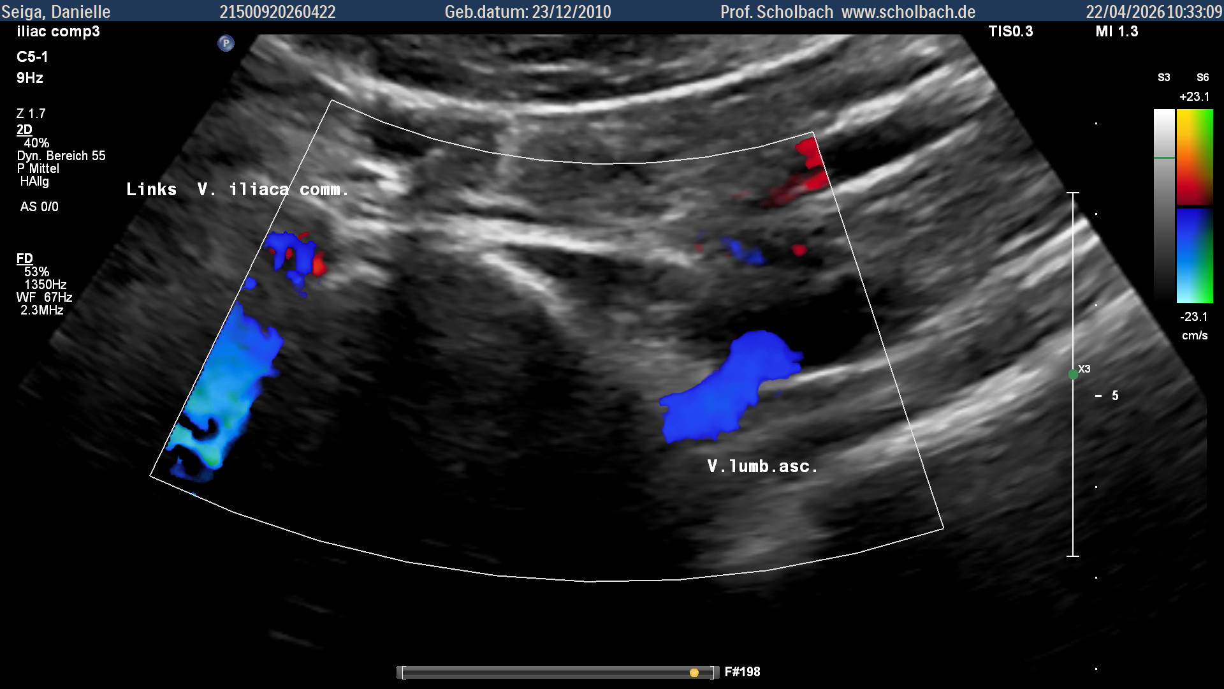
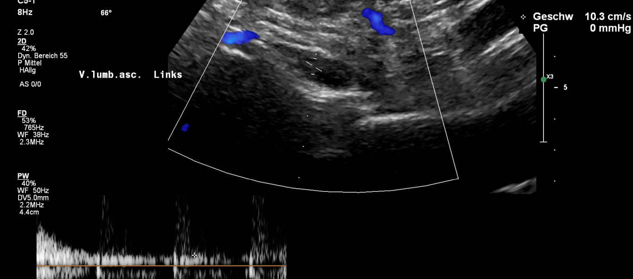
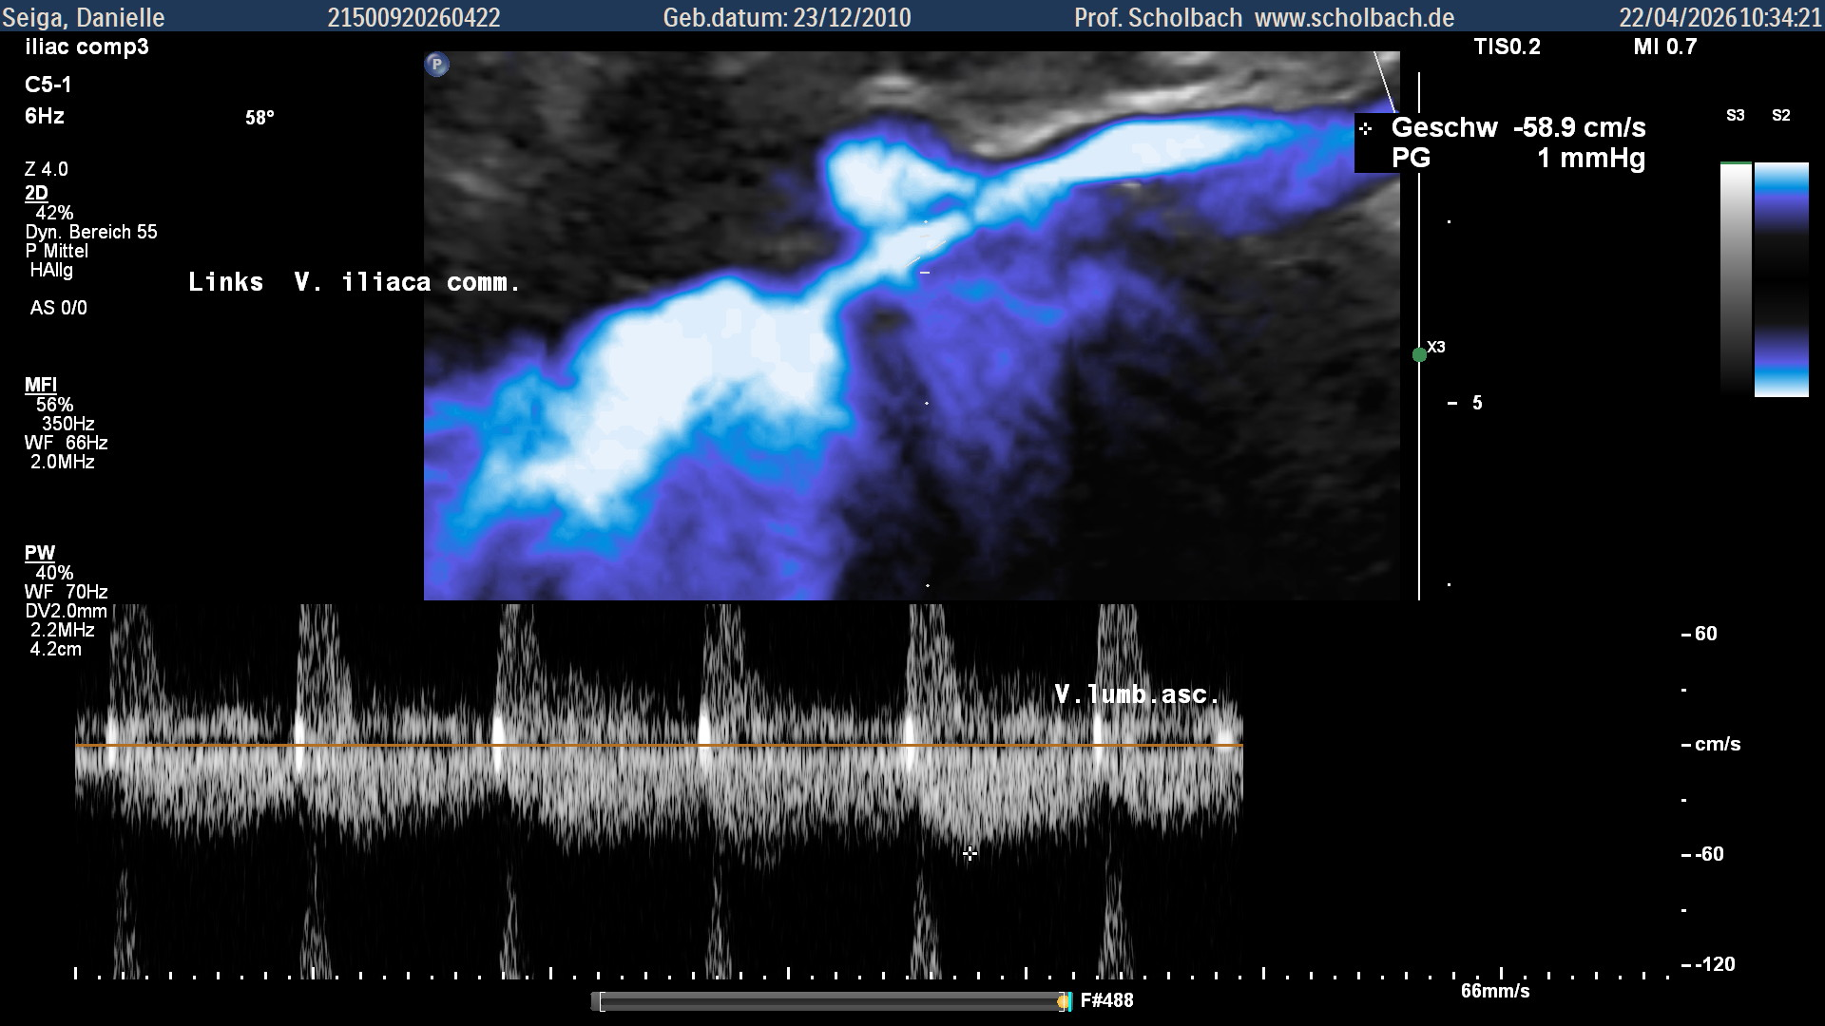
Left common iliac venous pressure gradient - unreliable
Reduced after development of collaterals! – 10 vs. 59 cm/s

Slide 15
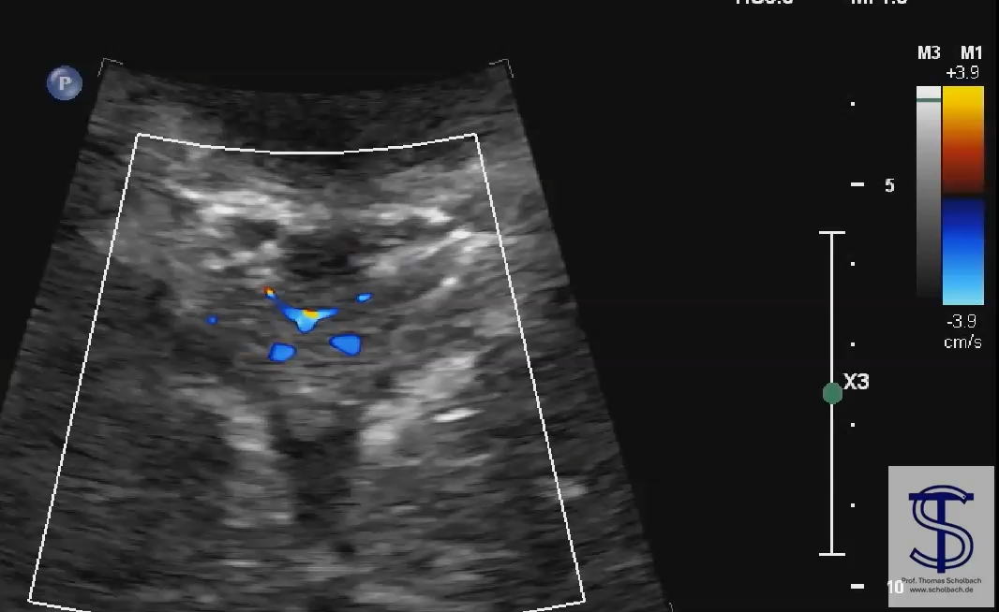
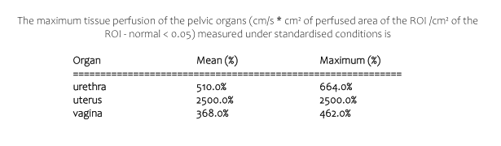
Pelvic organ congestion measurement with PixelFlux©
bladder
urethra
vagina
rectum

Slide 16
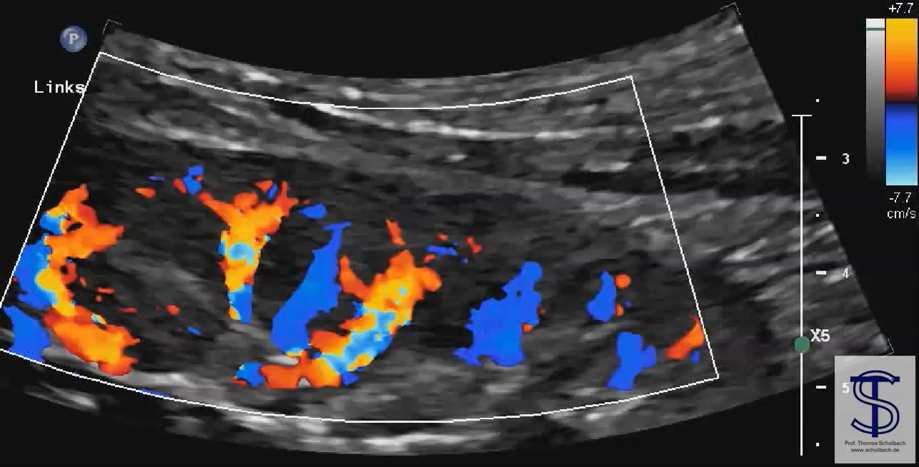
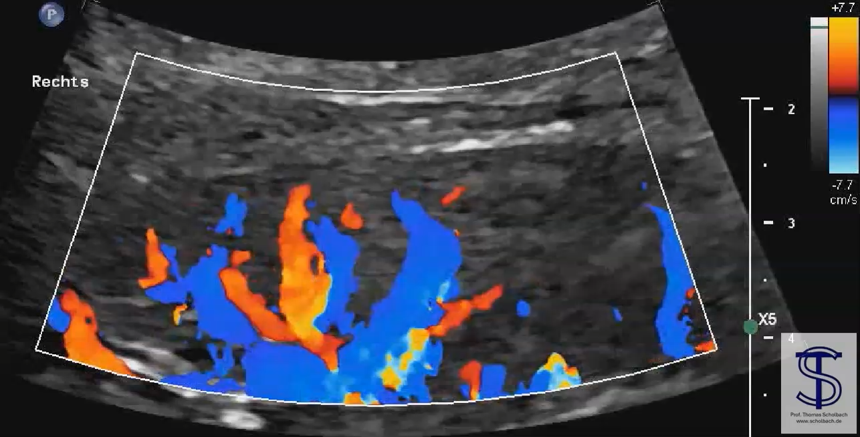
Renal parenchymal perfusion measurement with PixelFlux©
Tissue Perfusion Volume = velocity * perfused area
[cm/s*(cm²perfused area/cm²ROI ]

Slide 17
Gender equal medicine needs to understand
Vascular compression syndromes are a female domain
  Take women‘s complaints seriously
Vascular compression syndromes are frequent
  Promoted by a flat abdominal cavity (lordosis, flat thorax, wide iliac wings)
  Occuring simultaneously from neck to knee
Remote symptoms are frequent due to insufficient collaterals
Proper estimation requires volume and tissue flow measurements
  See separate talk

Slide 18
Thank you for listening!

