Slide 1
Towards a paradigm shift in diagnosing venous compression syndromes
A-162
Thomas Scholbach - Leipzig
Practice for functional ultrasound www.scholbach.de
Conflict of interest:
Prof. Dr. med. habil. Thomas Scholbach together with his son ,
Prof. Dr. rer. nat. habil. Jakob Scholbach
created the PixelFlux technique and
4D-PixelFlux volume flow measurement technique.
His son is the owner of the company Chameleon Software
www.chameleon-software.de
Notes:
Folie 1: Titel, Autoren, Affiliation, Disclosure-Informationen, Posternr.

Slide 2
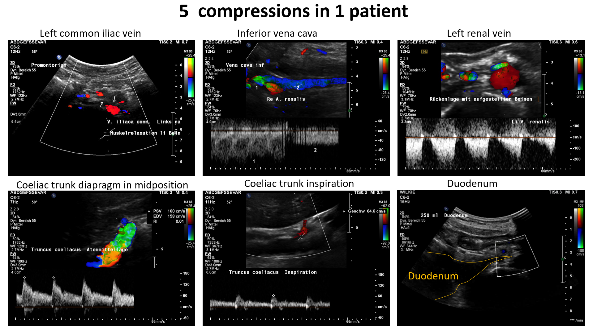
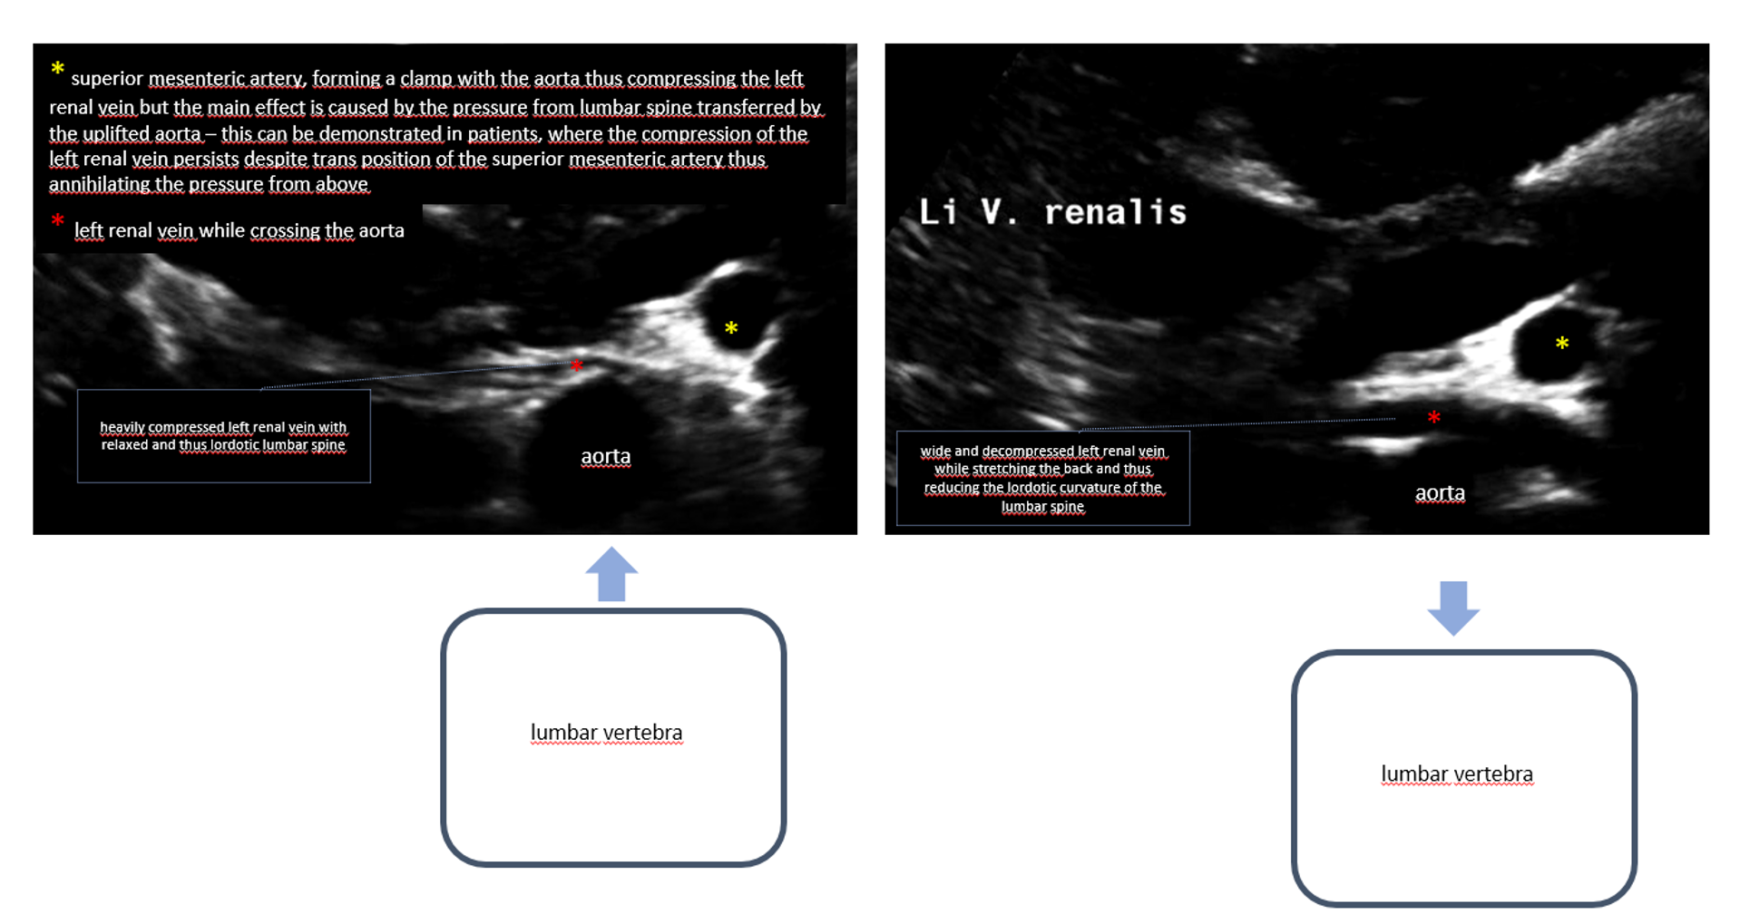
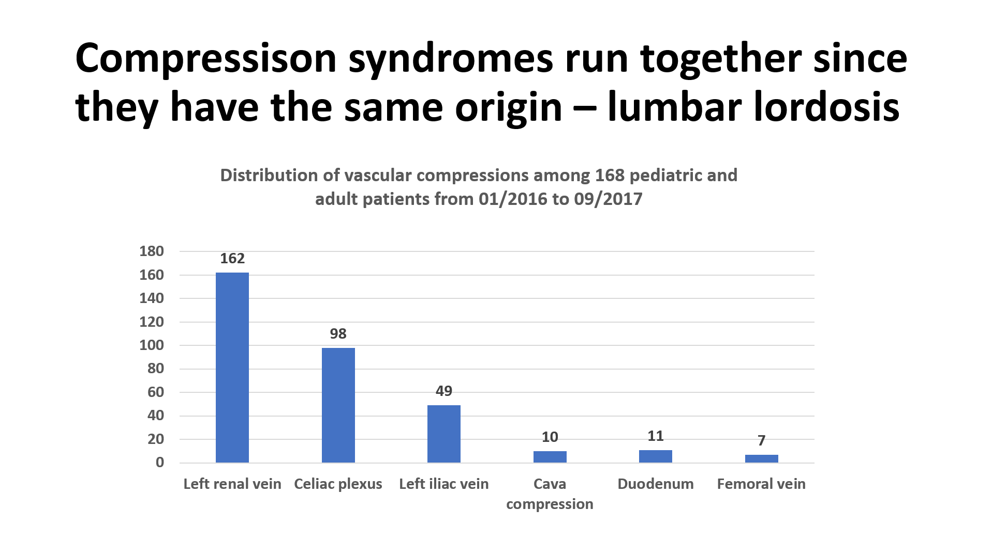
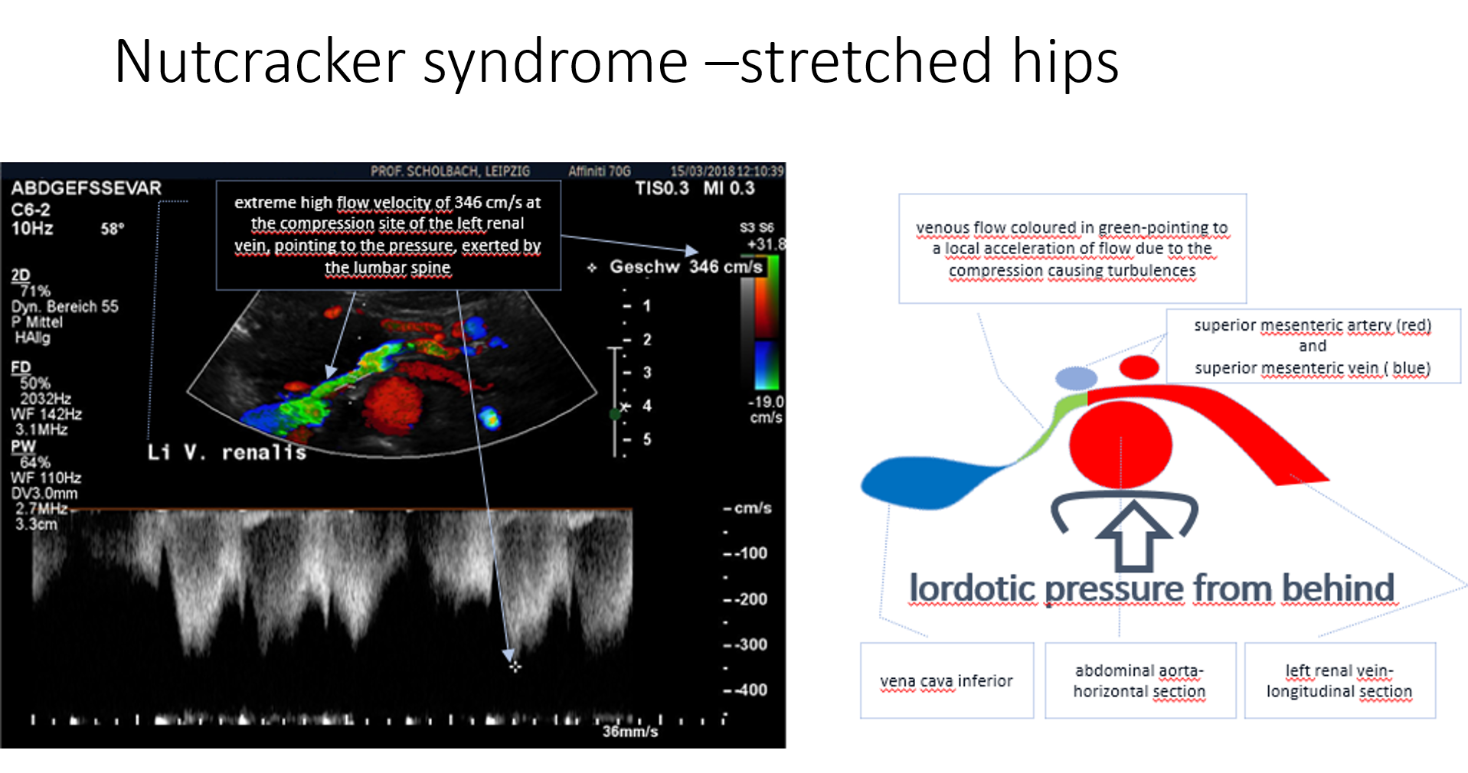
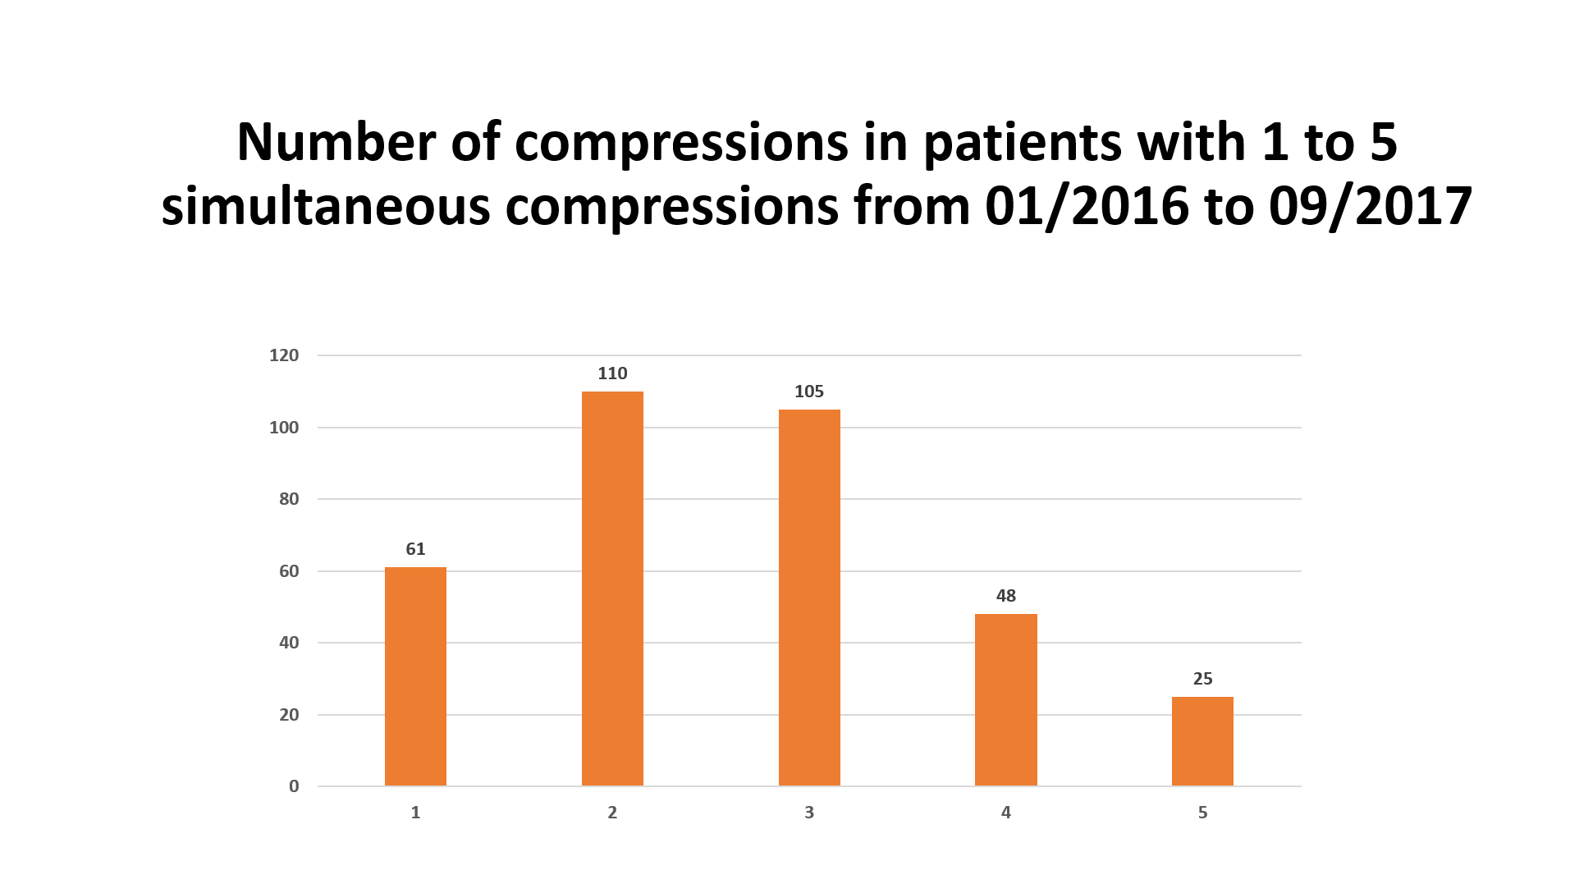
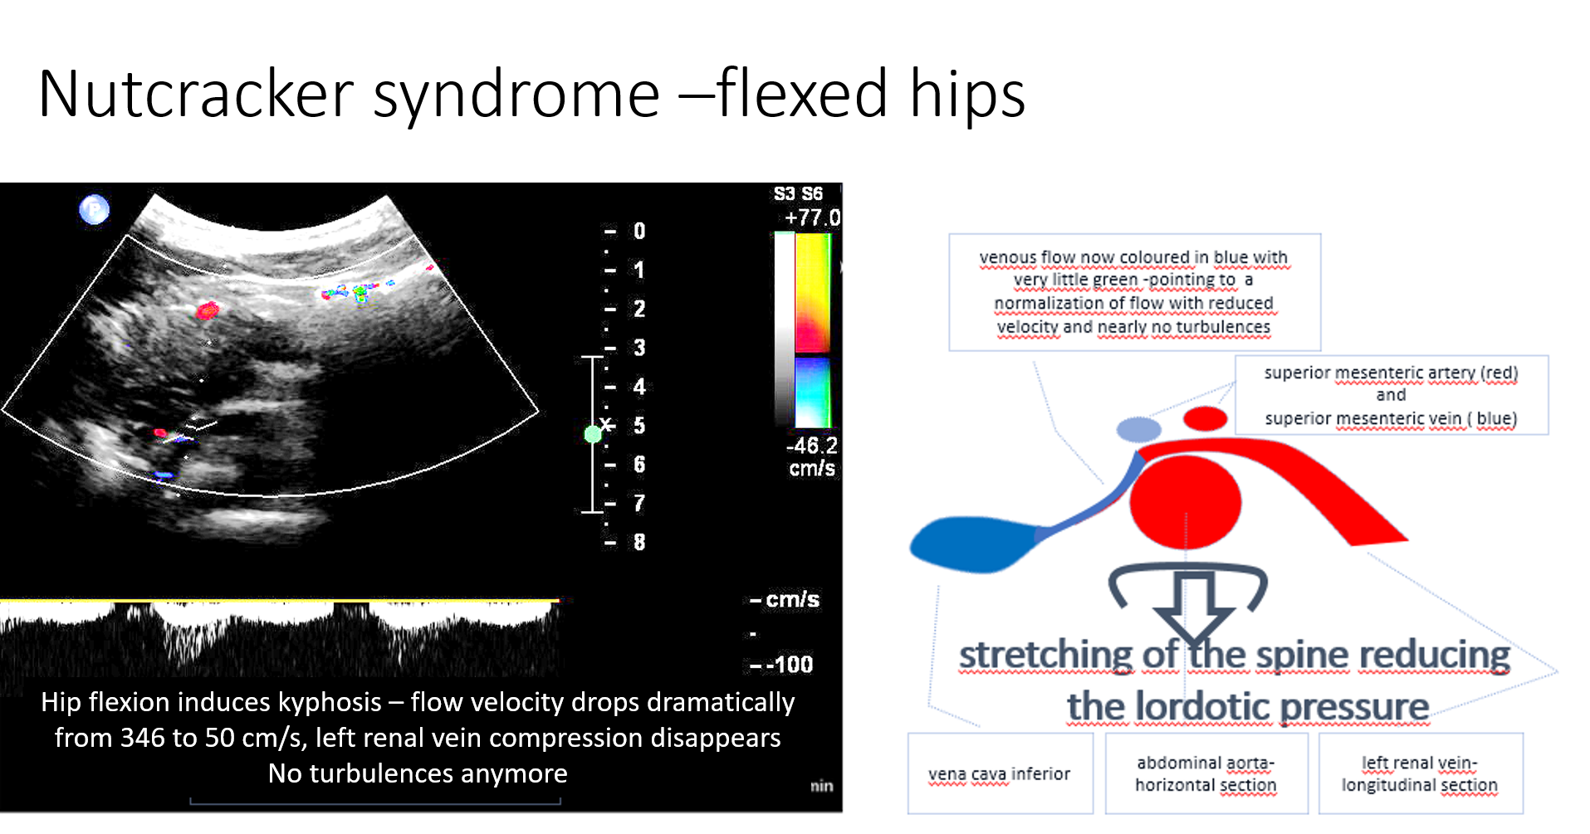
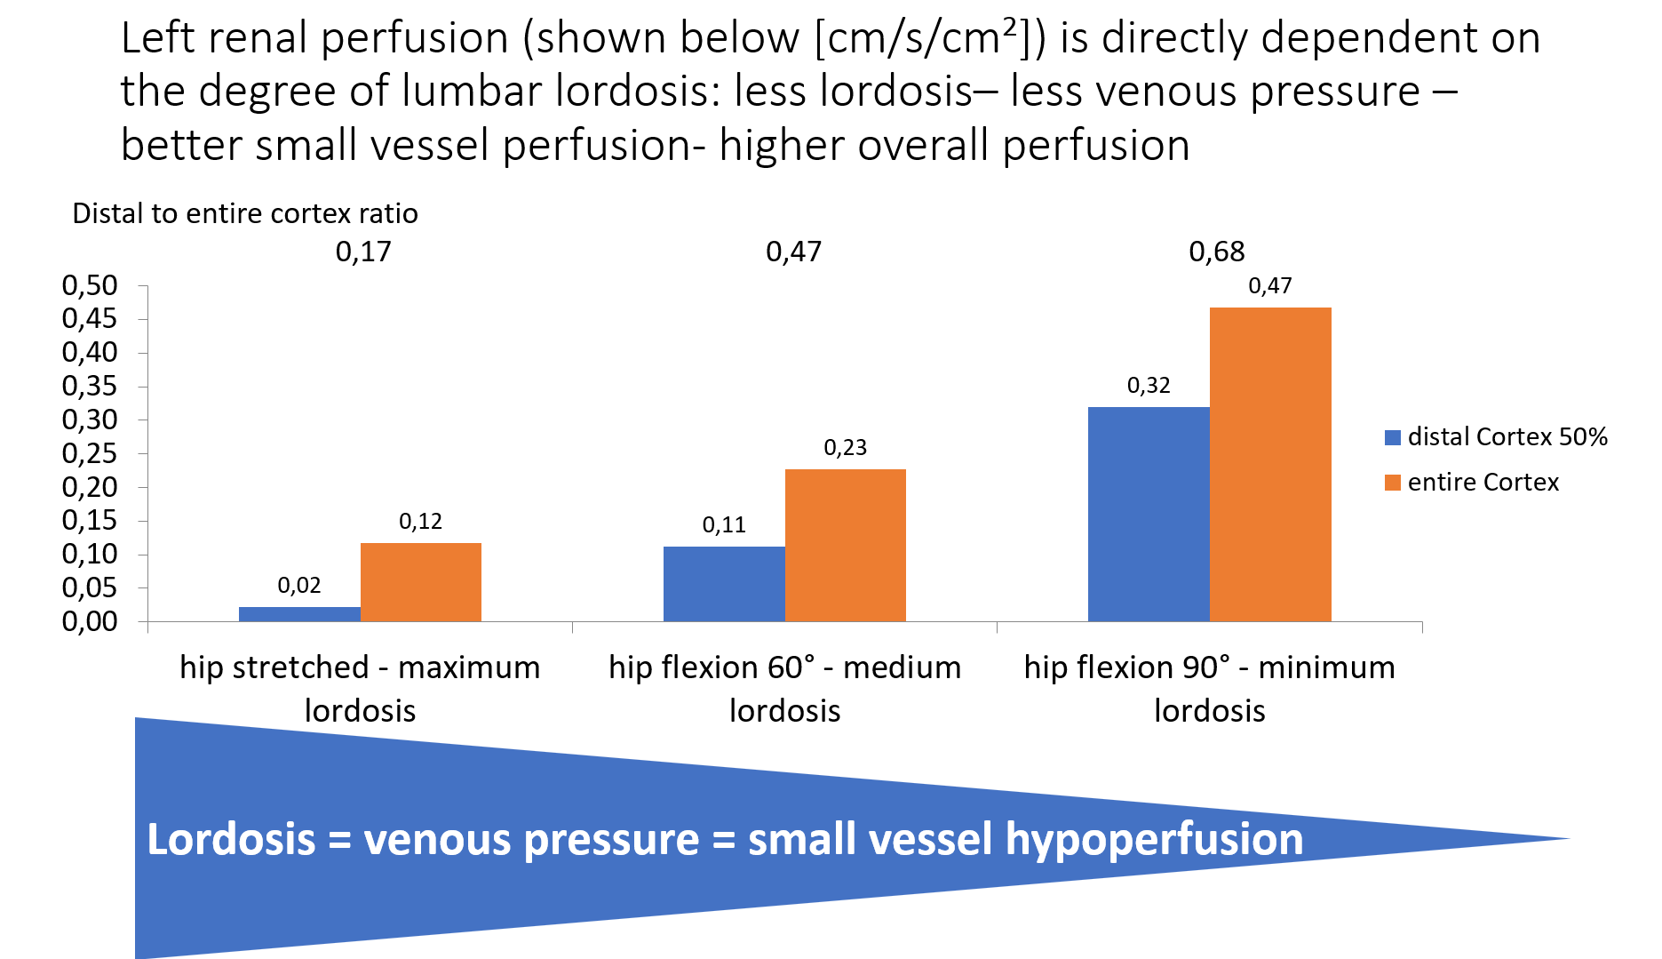
Current paradigm
vascular compression syndromes are
Conflicting observations in many thousands of diagnosed patients from 1990-2026 VCS are
1. rare
„Nutcracker“-;May-Thurner-; Dunbar-; Wilkie-syndrome
2. single entities
3. circumscribed
4. characteristic symptoms
5. threshold values (size, flow velocities) define the diagnosis
6. morphology + local symptoms create a diagnosis of VCS
7. Examination in lying posture
Frequent : 1502 patients from 2020-2026 90% female
Multiple
Developing – starting in pubertal growth spurt
Devastating – starving, extreme pain leads to suicides
Somatic – not psychogen
Holistic – affecting from head to toe
Overlapping - connected by collaterals, clustering at the midline
parts of a midline syndrome – lordotic compression
Arguments for a new paradigm
Vascular compressions are synchronous multiple facets of midline syndrome
Morphology
Vascular compressions are synchronous multiple facets of midline syndrome
Morphology
All compressions belong together
Lordosis is the driver of all vascular compressions
Flow acceleration
Flow acceleration
Need for a dynamic examination
Need for a dynamic examination
Functional
PixelFlux renal tissue perfusion measurements
Orthostatic effect on central circulation due to additional orthostatic venous pooling in front of the compression sites blocking the venous return to the heart
Updated Paradigm
Vascular compression syndromes are frequent
Anyone with chronic pain, especially women, require a thorough workup for all vascular compressions
Multiple compressions usually occur simultaneously in an individual
VCS deteriorate over time
VCS symptoms overlap
Symptoms occur far away from the compression site due to collateral circulation effects
Symptoms are multifaceted due to the impact on the function of multiple organs
Diagnosis requires in addition to morphology, flow velocities and local symptoms flow volume and tissue perfusion measurements (PixelFlux) to define local and remote perfusion changes that needs to be correlated to the remote symptoms
Notes:
Folie 2: Einleitung, Einschlußkriterien und Methoden, Ergebnisse

Slide 3
The diagnosis of multiple compression syndromes requires a new approach
Focusing on morphology (narrowing of the vessel), local symptoms (pain at the compression site, haematuria in left renal vein compression, left leg thrombosis thrombosis in the left common iliac vein compression) and simple flow velocity measurements do not reflect the systemic and functional nature of simultaneously occurring multiple compressions in one individual.
The collateral network is causing a fancy array of remote symptoms. The disturbed perfusion of organs needs to be quantified and correlated to remote symptoms. This requires a
New paradigm of vascular compressions:
Vascular compression syndromes are
frequent
female (90%)
multifaceted function dependent (varying with body posture, uptake of food and physical activities)
compressions of various abdominal structures (veins, arteries, intestines, nerves) that require the measurement of
flow volumes and tissue perfusion of the affected organs in order to
correlate perfusion changes with the respective
organs symptoms - functional deficits and
pain – the predominant symptom anywhere.
Notes:
Folie 3: Schlussfolgerung

