Slide 1
Diagnosis and treatment of the Nutcracker Syndrome
Thomas Scholbach - Leipzig - Practice for functional ultrasound - www.scholbach.de

Slide 2
Conflict of interest:
Prof. Dr. med. habil. Thomas Scholbach together with his son ,
Prof. Dr. rer. nat. habil. Jakob Scholbach created the PixelFlux technique and
4D-PixelFlux volume flow measurement technique.
His son is the owner of the company Chameleon Software.

Slide 3
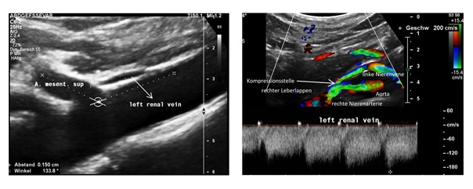

No Nutcracker but lordogenetic compression

Slide 4
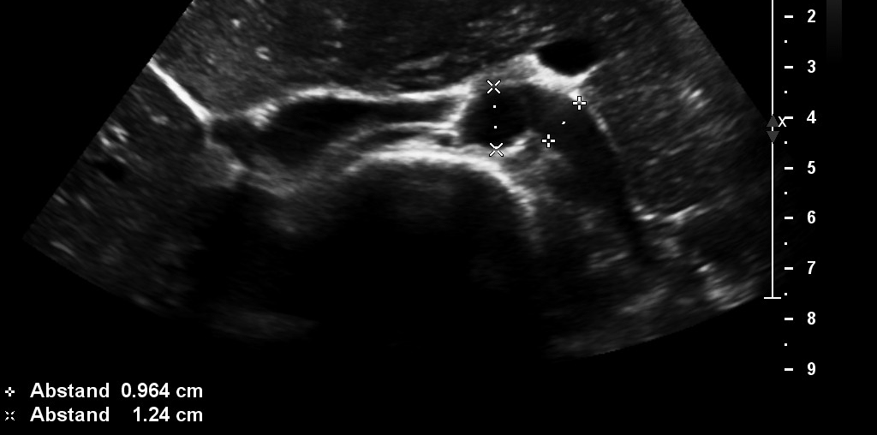
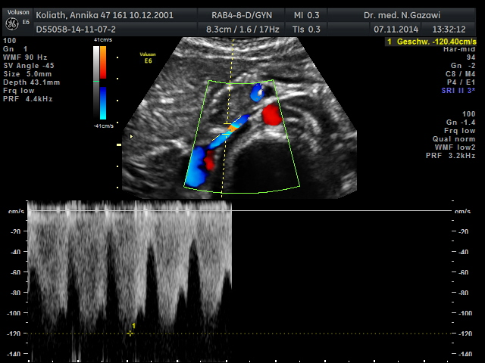
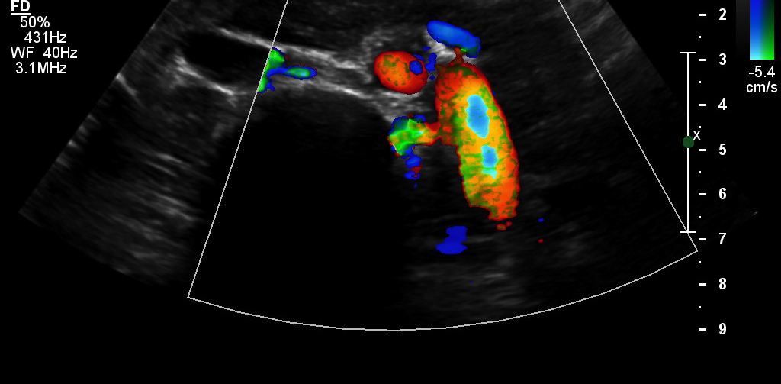
The nutcracker syndrome - a misnomer: NOT SMA but RRA is the most frequent compressor but also the stomach of jejunum may compress the LRV
Persistent LRV compression after caudaltransplantation of SMA
LRV compression before caudaltransplantation of SMA

Slide 5
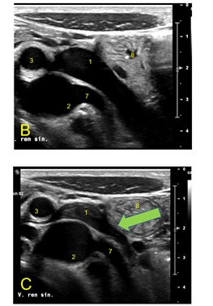
Gastrointestinal compression of the left renal vein
Venous compression syndromes may masquerade as gastrointestinal issues if the filling GI tract adds to the compression of the vein
If post-prandial symptoms are not explainable by standard GI diagnostics of venous compression needs to be ruled out
Irritable bowel syndrome is frequently an undiagnosed abdominal compression syndromes
Post-prandial peristalsis of the jejunum (8) exerts additional pressure onto a painfully congested left renal vein (1).
Clinical consequence: Post-prandial pain

Slide 6
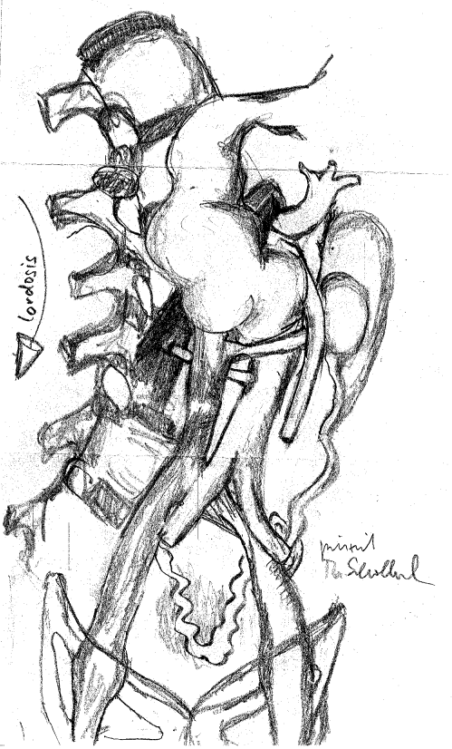
All abdominal compression syndromes are consequences of a flat abdominal cavity due to strong lumbar lordosis and shallow thorax
Left renal vein
Celiac artery
Left common iliac vein
Duodenal compression
Inferior vena cava (3 preferred locations)
Pelvic congestion syndrome*
Midline congestion syndrome*
Lumbar artery compression
Femoral veins
Left brachiocephalic vein
Internal jugular vein
Portal vein
Splenic vein
Superior mesenteric vein
Jejunal vein
Internal iliac vein
Stomach
Celiac plexus
Pudendal nerve
Spinal and cerebral congestion*
Popliteal vein
Cubital vein
Subclavian / Brachial vein
2
4
1
8
5
3
9
6
* Clinically important sequelae of vasc. compressions

Slide 7
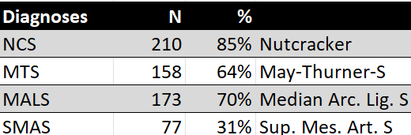
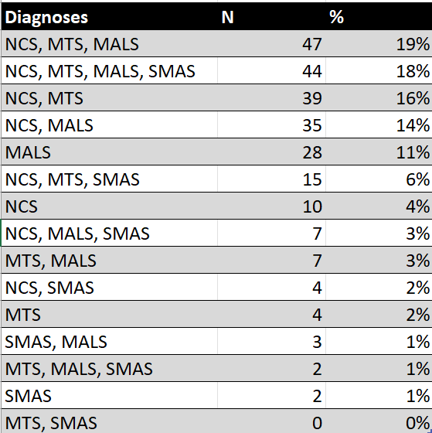

NCS Patients 2017 - 2024
Diagnosed > 01/2020
Age | years
Min | 6
Max | 81
Mean | 34,6
Female | 90%
N =839
Operated > 01/2017
Age | years
Mean | 31,1
Female | 83%
hEDS | 70%
External PTFE grafts | 100%
Nephropexy | 48%
N =247

Slide 8
Nußknacker
Nußknacker
Linke Niere
Gestaute linke Nierenvene
Linke Nierenvene
Aorta
A. mes. sup.
Untere Hohlvene
Linke
Eierstock
vene
May-Thurner
Linker Eierstock
y
Varizen
Gebärmutter

Slide 9
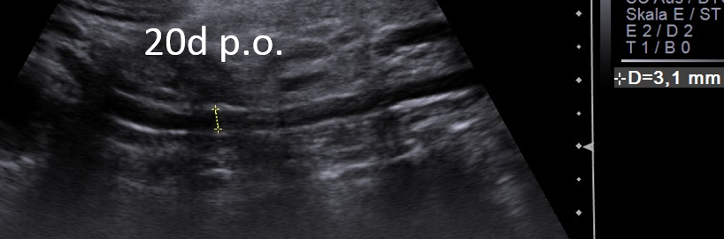
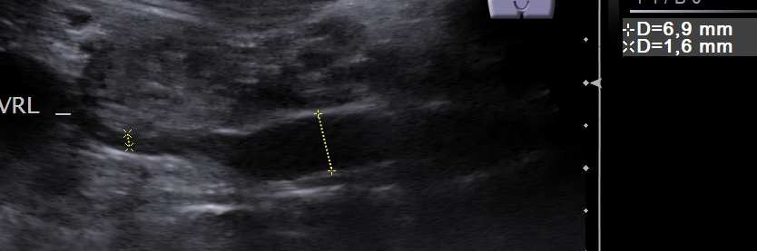
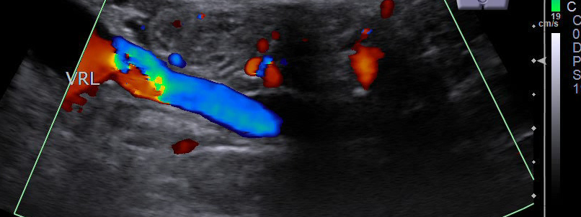
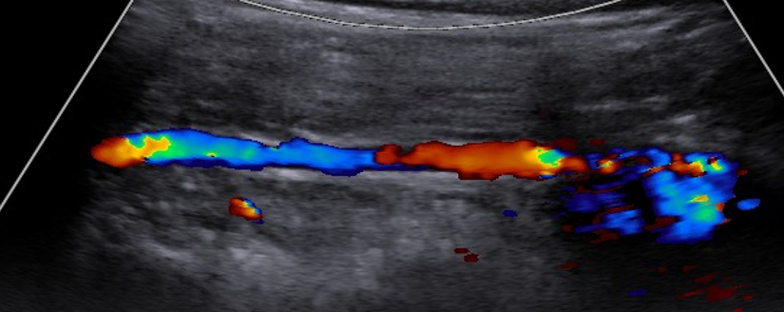
LOV – pressure transfer
LRV compressed
LRV decompressed
7 mm
Kollaps der V. ovarica sin. 8 > 3mm
3 mm
20d p.o.
cranial
Flow direction
cranial
Flow direction
Restitution of cranial flow

Slide 10
How diagnose NCS?
1. correlation of symptoms – near and remote – with narrowing of LRV and collaterals
3. organ perfusion: kidneys, pelvic organs, brain
4. find the other VCS!

Slide 11
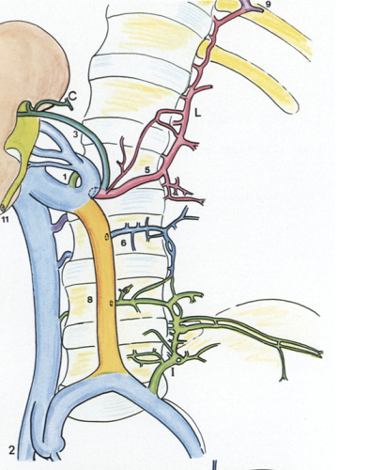
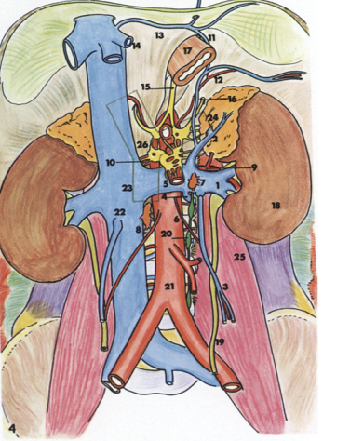
Numerous anastomoses of the left renal vein
V. suprarenalis
lateral root of the
V. hemiazygos
V. lumbalis
V. iliolumbalis
Arcus reno-cavalis
from aauz.com

Slide 12
Symptoms Midline syndrome: pain and dysfunction of midline organs from vertex to symphysis
Head
  headache - positional
  visual disturbance
    Blurred vision
    Double vision
  migraine
    Starting in the neck
  snoring
  nasal congestion
  disturbed swallowing
  tinnitus
Spine - Thorax
  back pain
    lumbar
    Iliac crest
  Scoliosis
  Flat thorax
  Pecten excavatum
  Asymmetric ribcage
  Slipping ribs
  Costal liver compression
periumbilical pain
flank pain
  Left – LRV
  Right – IVC / LCIV Urinary bladder
  pollakisuria
  Seldom proteinuria
  Rarely hematuria
  dysuria
  Urinary retention
    Bending forward
    Straining
    Self catheterization
Genitals
  dyspareunia
  Unpleasant sexual arousal
  Perineal pain – pudendal neuralgia
  vulvar varices
  dysmenorrhea
  prostatitis
  Left > right varicocele
Intestines
  constipation
  Nausea postprandially aggravated
  Vomiting
  Slow transit
  Reduced peristalsis
  hemorrhoids
  rectal bleeding
  vomiting
Legs
  left leg varices
  Swelling
  Bluish discoloration
  sciatica and other neuropathic signs
  Tension - bursting pain
  Weakness – paralysis - spasticity
Lungs
  blocked inspiration
  sighs
  air hunger
  hyperventiation

Slide 13
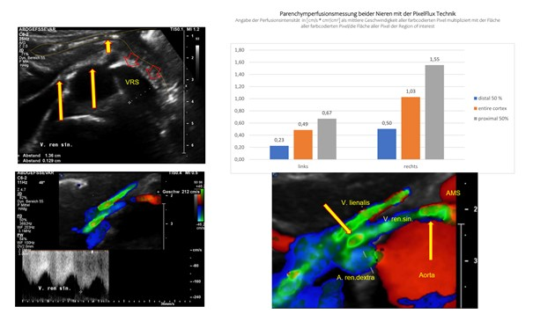
PixelFlux is the key to understanding the problem

Slide 14
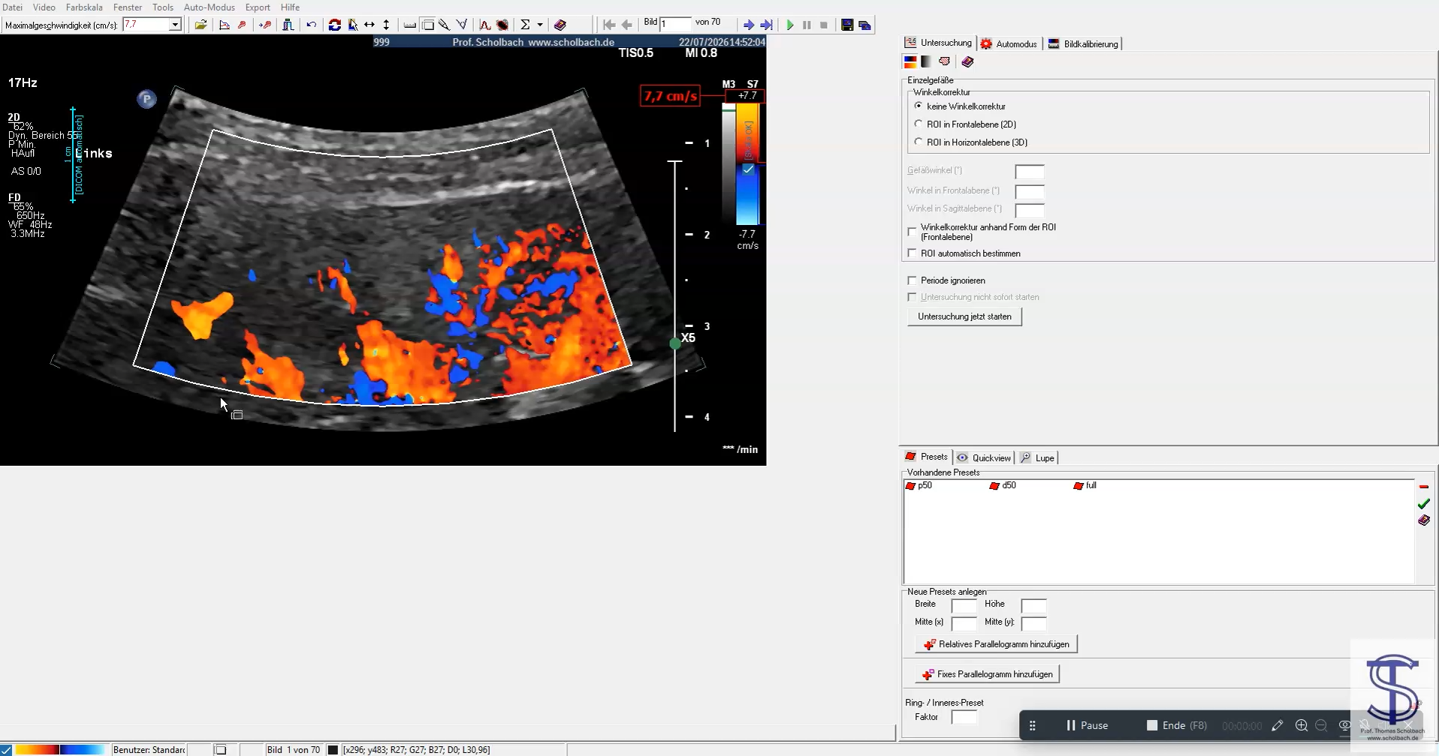
Renal PixelFlux-measurement – the cornerstone of dynamic functional diagnostics

Slide 15
How to evaluate collaterals?
Find them
Measure their volume flow
Measure the effect on organ perfusion (PixelFlux)
Check the entire circulation
  kidney – pelvis – IVC - liver – small bowel– spine – Jugulars – brachiocephalic - SVC

Slide 16
How to evaluate left renal vein compression properly?
Left renal vein compression
Left ovarian vein
PixelFlux
Renal parenchymal perfusion
Tronc rénorachidièn
High collateral volume flow
Left suppressed
Additional May-Thurner
Left kidney under pressure
Symptoms: Left flank, mid abdomen
postprandial
More severe genital, pudendal rectal and leg symptoms
Spinal congestion likely – cerebral and spional neurology
Left equal right
Remote symptoms
(brain,pelvis, legs,IVC)
Spinal /cerebral symptoms
Genital,leg, pelvic symptoms
Additional May-Thurner
More severe genital, pudendal rectal and leg symptoms
Additional IVC compression
Spinal congestion likely – cerebral and spinal neurology
RLQ pain
Right leg symptoms
RUQ pain, liver and small bowel symptoms
Left flank, mid abdomen
postprandial
Internal jugular vein compression
4D-PixelFlux
Cerebral congestion depending on additional epidural influx
4D-PixelFlux
Gluteal and internal pudendal venous flow volumes
PixelFlux
Uterus, urethra, vagina rectum, external genitalia
4D-PixelFlux
Superior mesenteric vein and artery

Slide 17
Summary
NCS is frequent
NCS is a problem of the flat abdominal cavity
  Lordosis, shallow thorax, wide iliac wings, lax connective tissue
  Rarely SMA involved
Midline syndrome – multiple compressions are the rule
Remote symptoms
Complete workup
Treatment by decompression
  PTFE tunnel
    Avoid any ovarian vein procedures, stents, autotransplantation, left renal vein transposition…..

