Slide 1
4D-PIXELFLUX Volume flow measurements of cerebral perfusion as a tool to quantify cerebral venous congestion
A-156
Thomas Scholbach - Leipzig
Practice for functional ultrasound www.scholbach.de
Conflict of interest:
Prof. Dr. med. habil. Thomas Scholbach together with his son ,
Prof. Dr. rer. nat. habil. Jakob Scholbach
created the PixelFlux technique and
4D-PixelFlux volume flow measurement technique.
His son is the owner of the company Chameleon Software
www.chameleon-software.de
.
Notes:
Folie 1: Titel, Autoren, Affiliation, Disclosure-Informationen, Posternr.

Slide 2
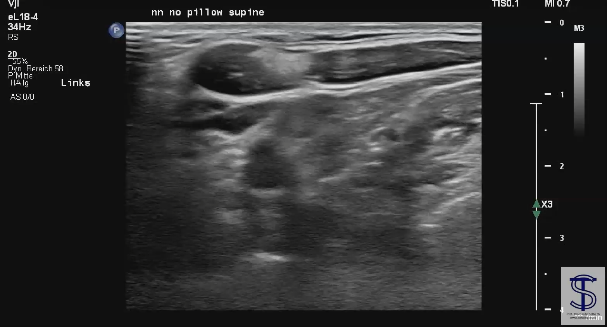
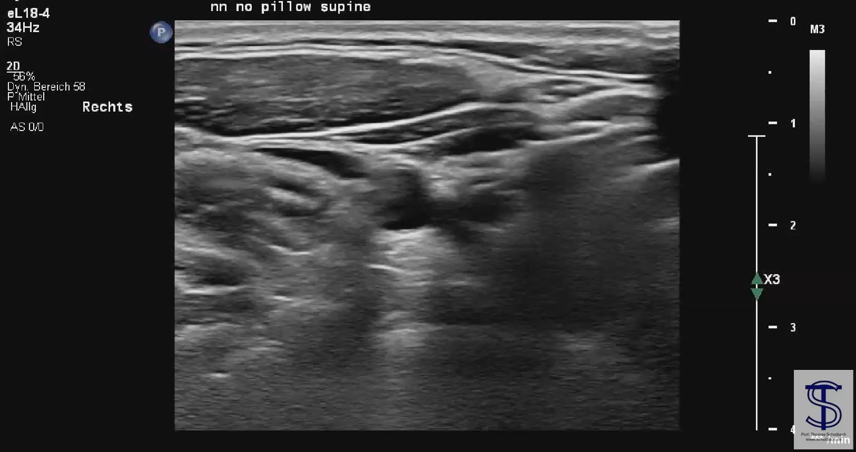
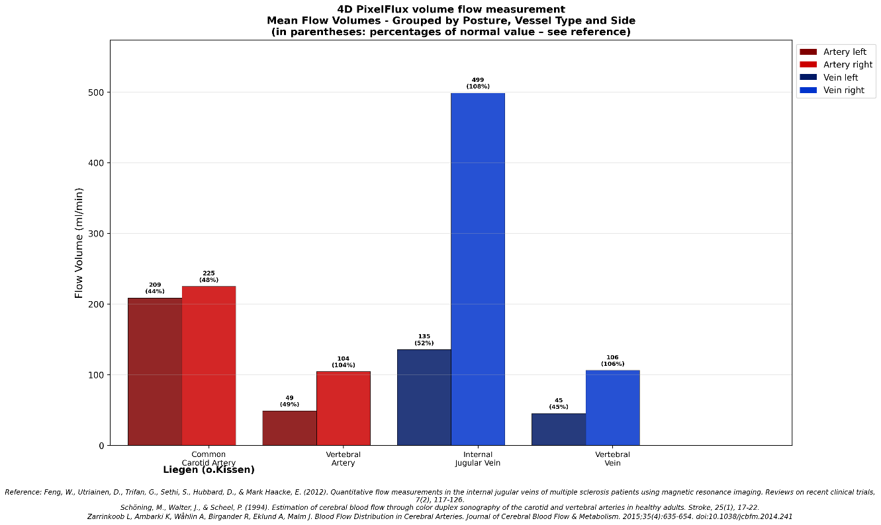
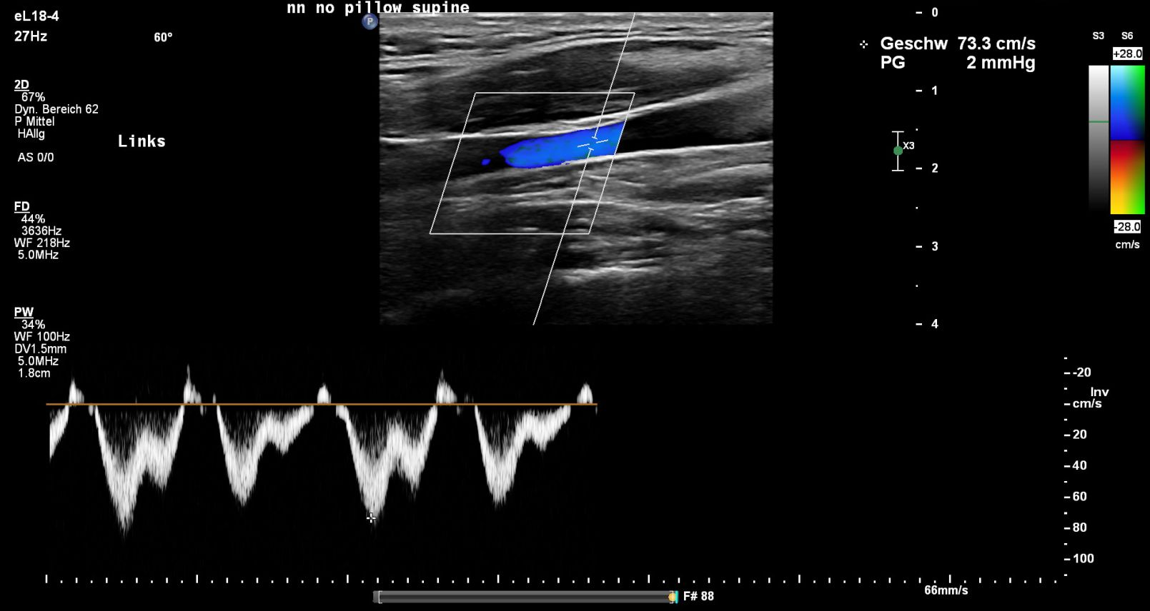
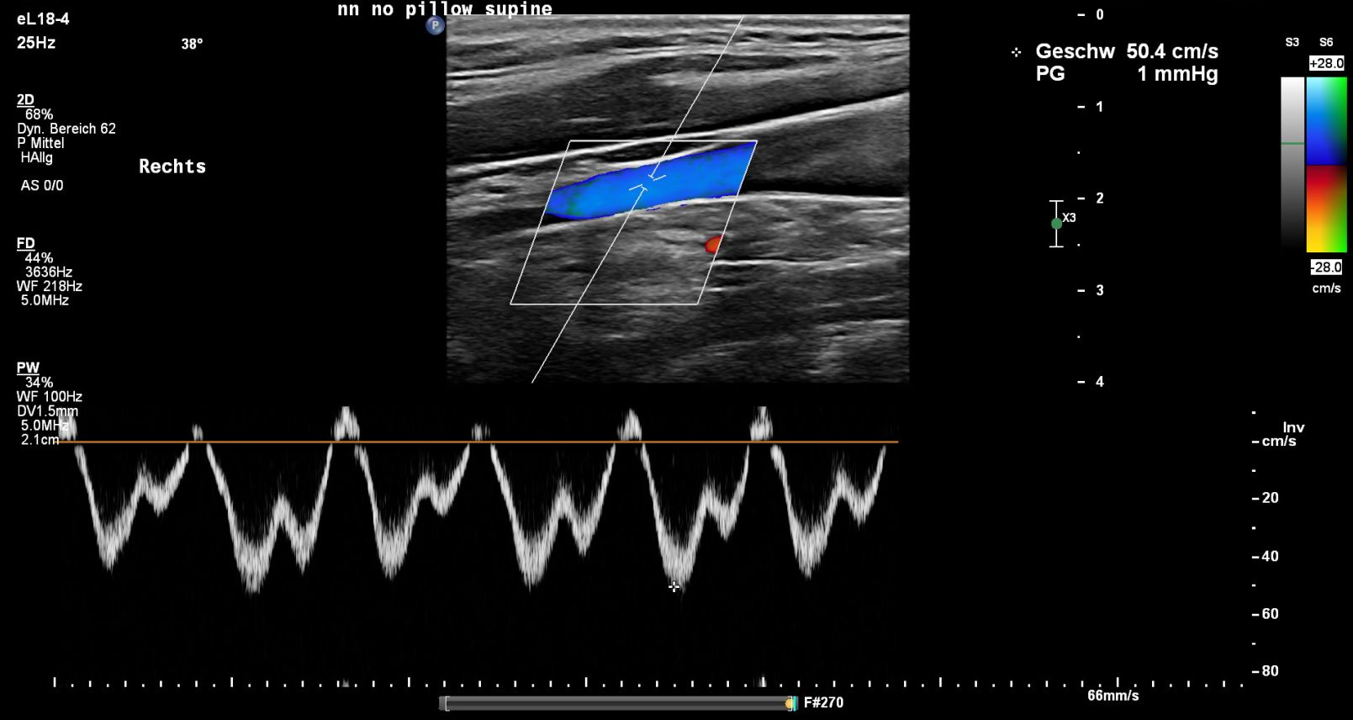
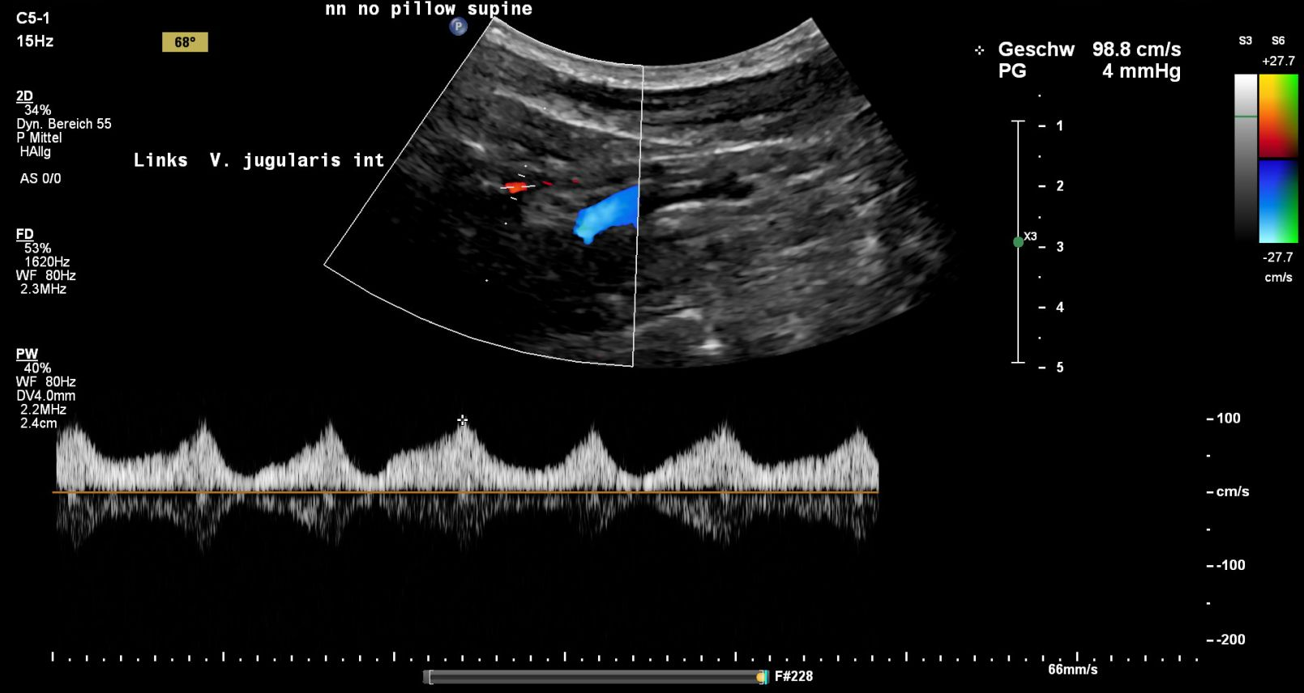
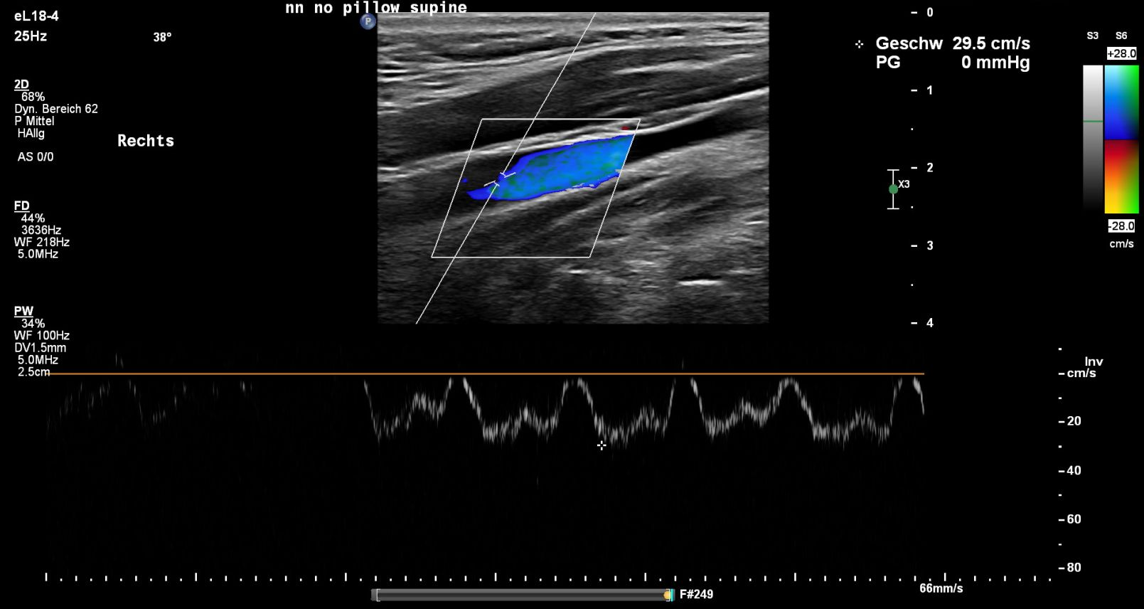
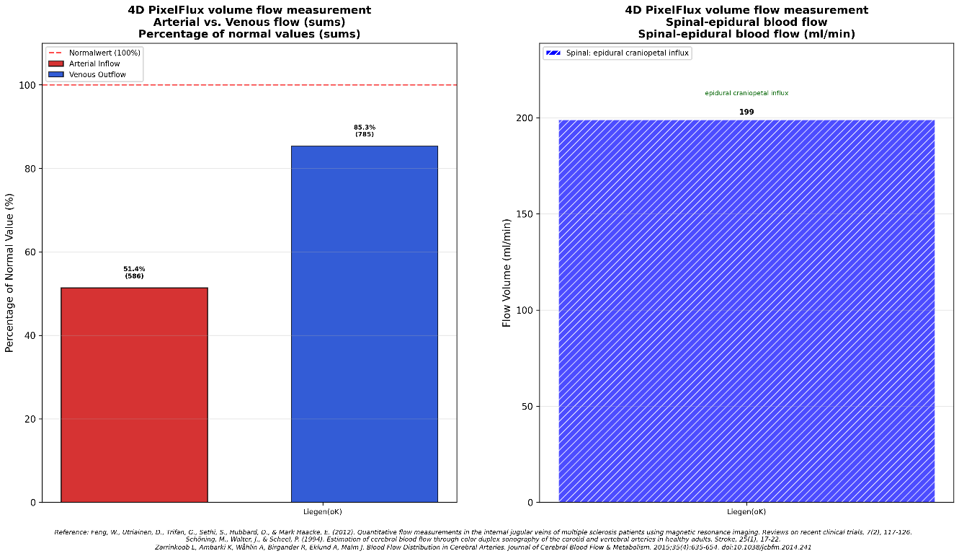
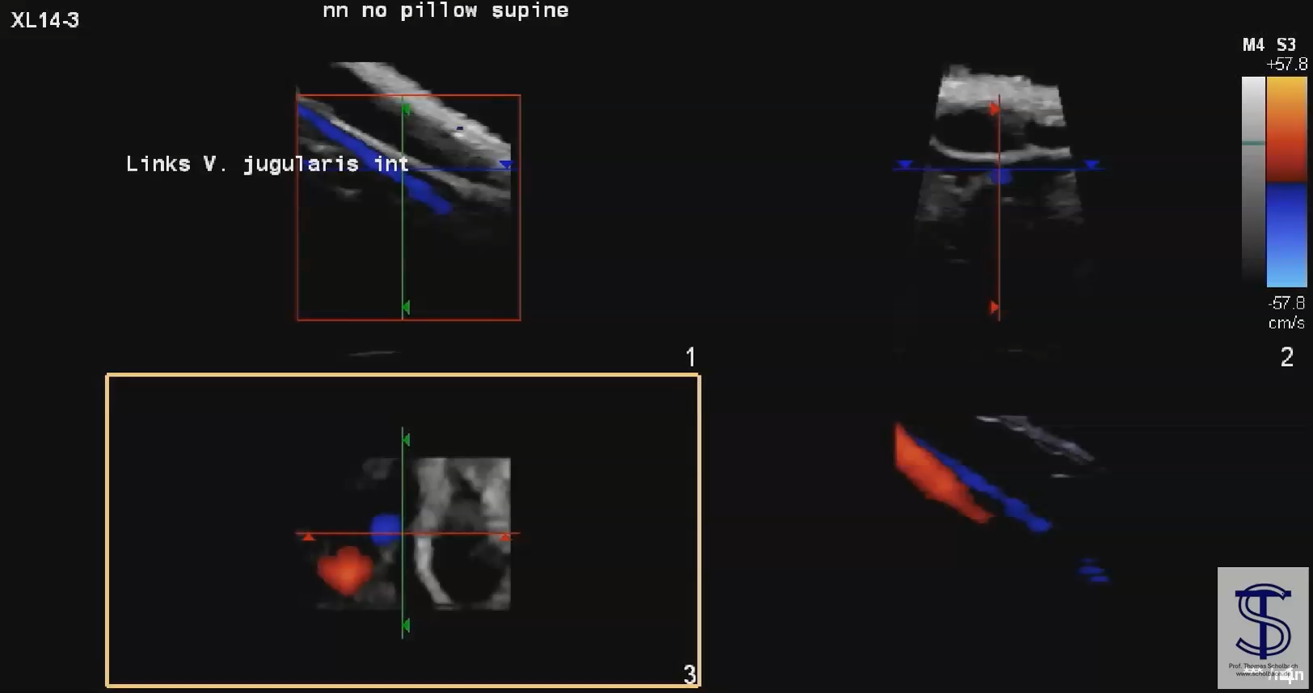
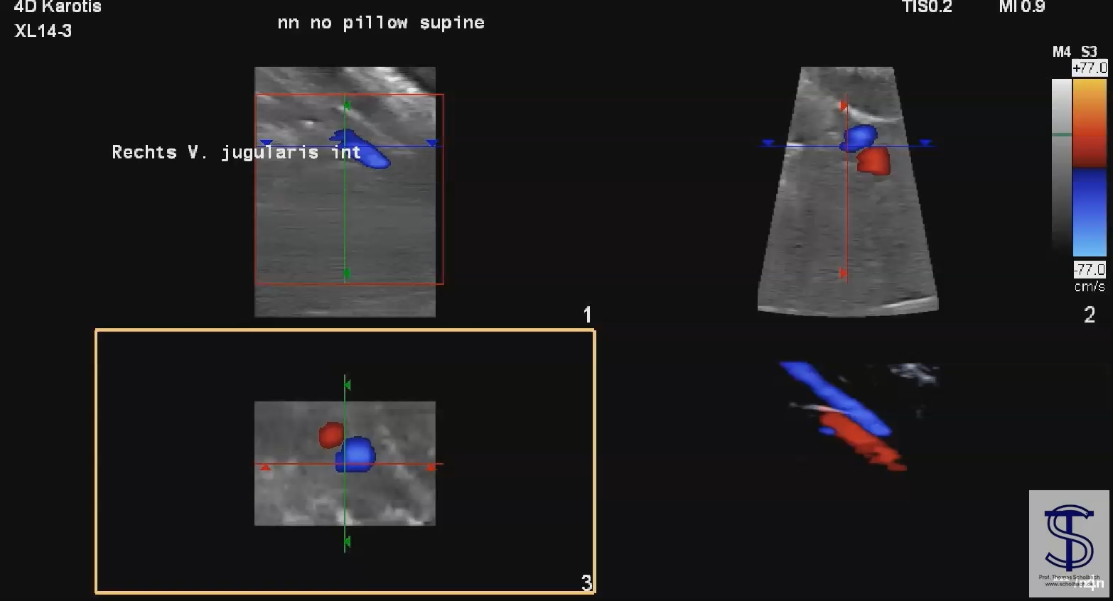
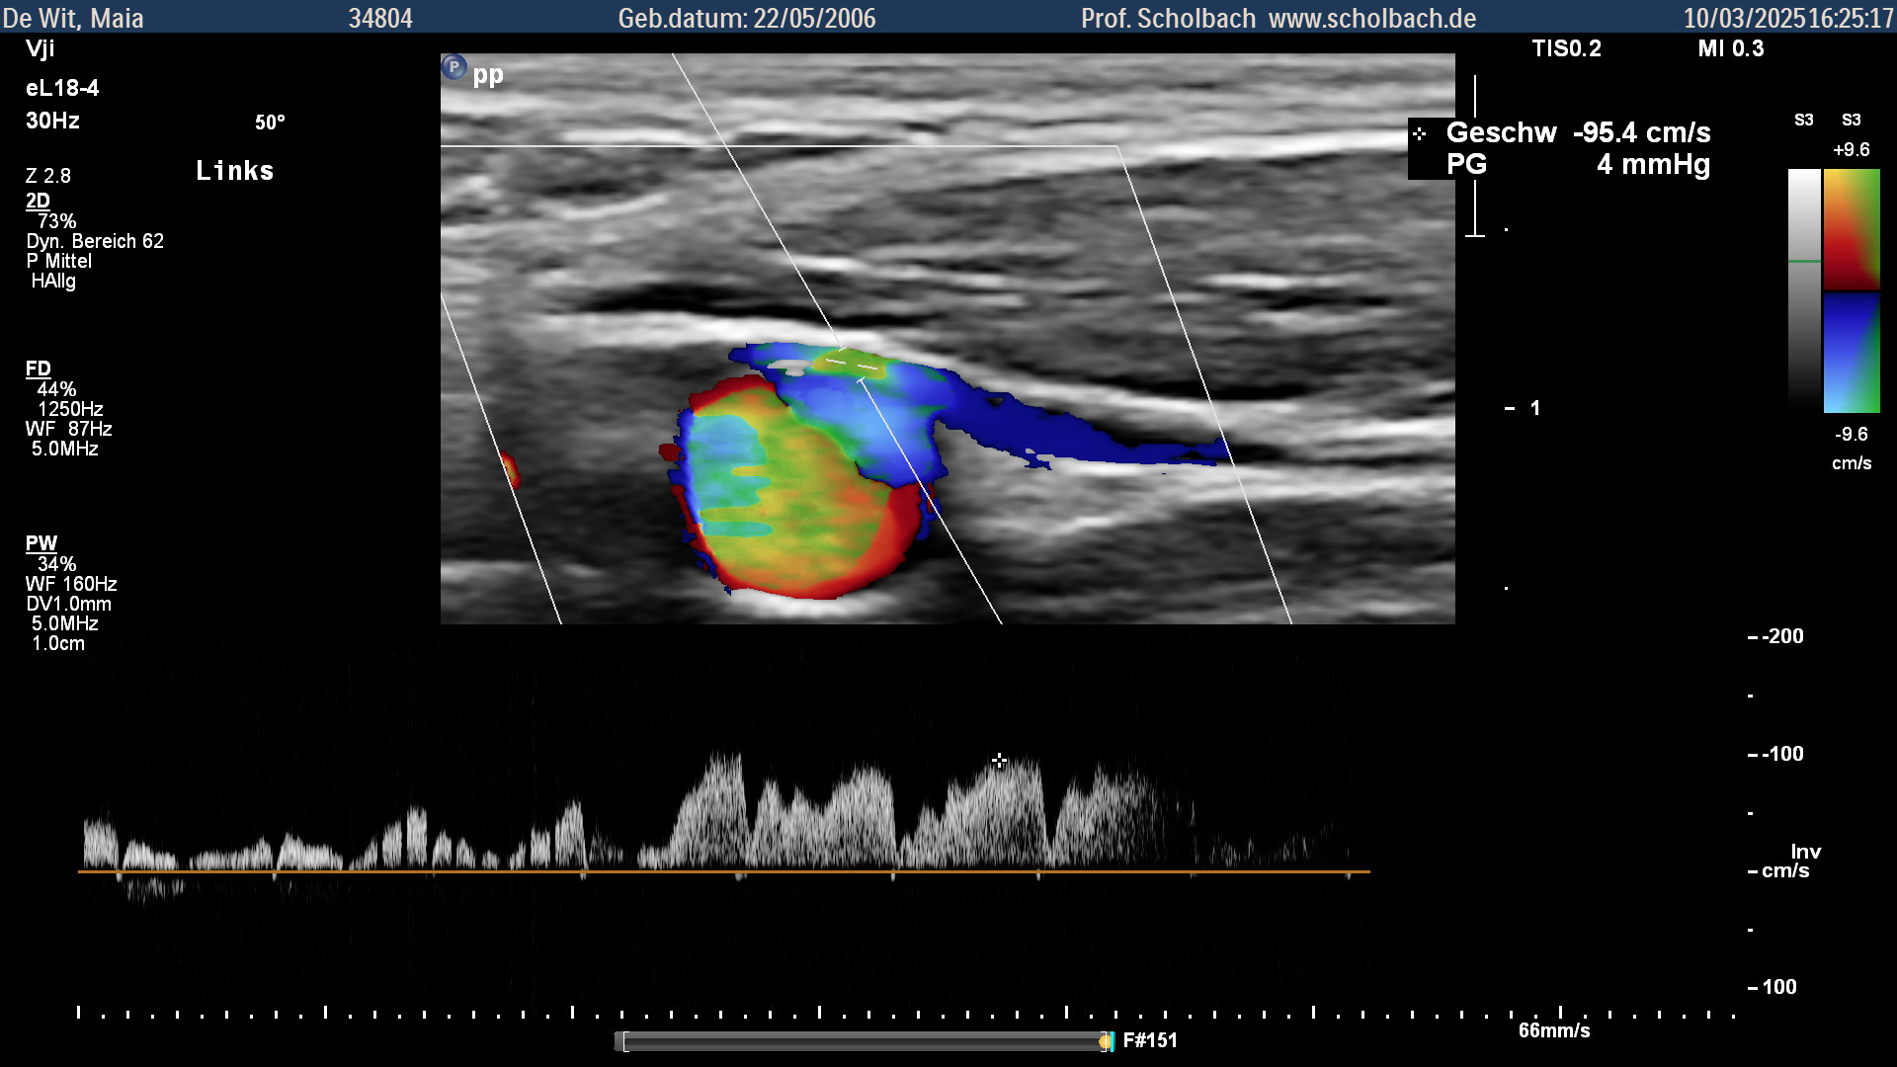
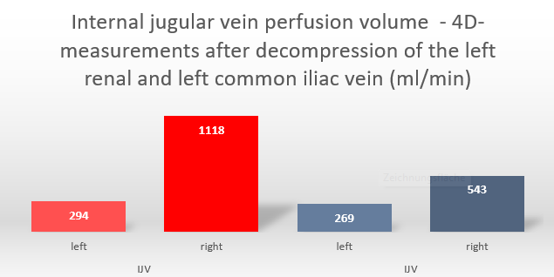
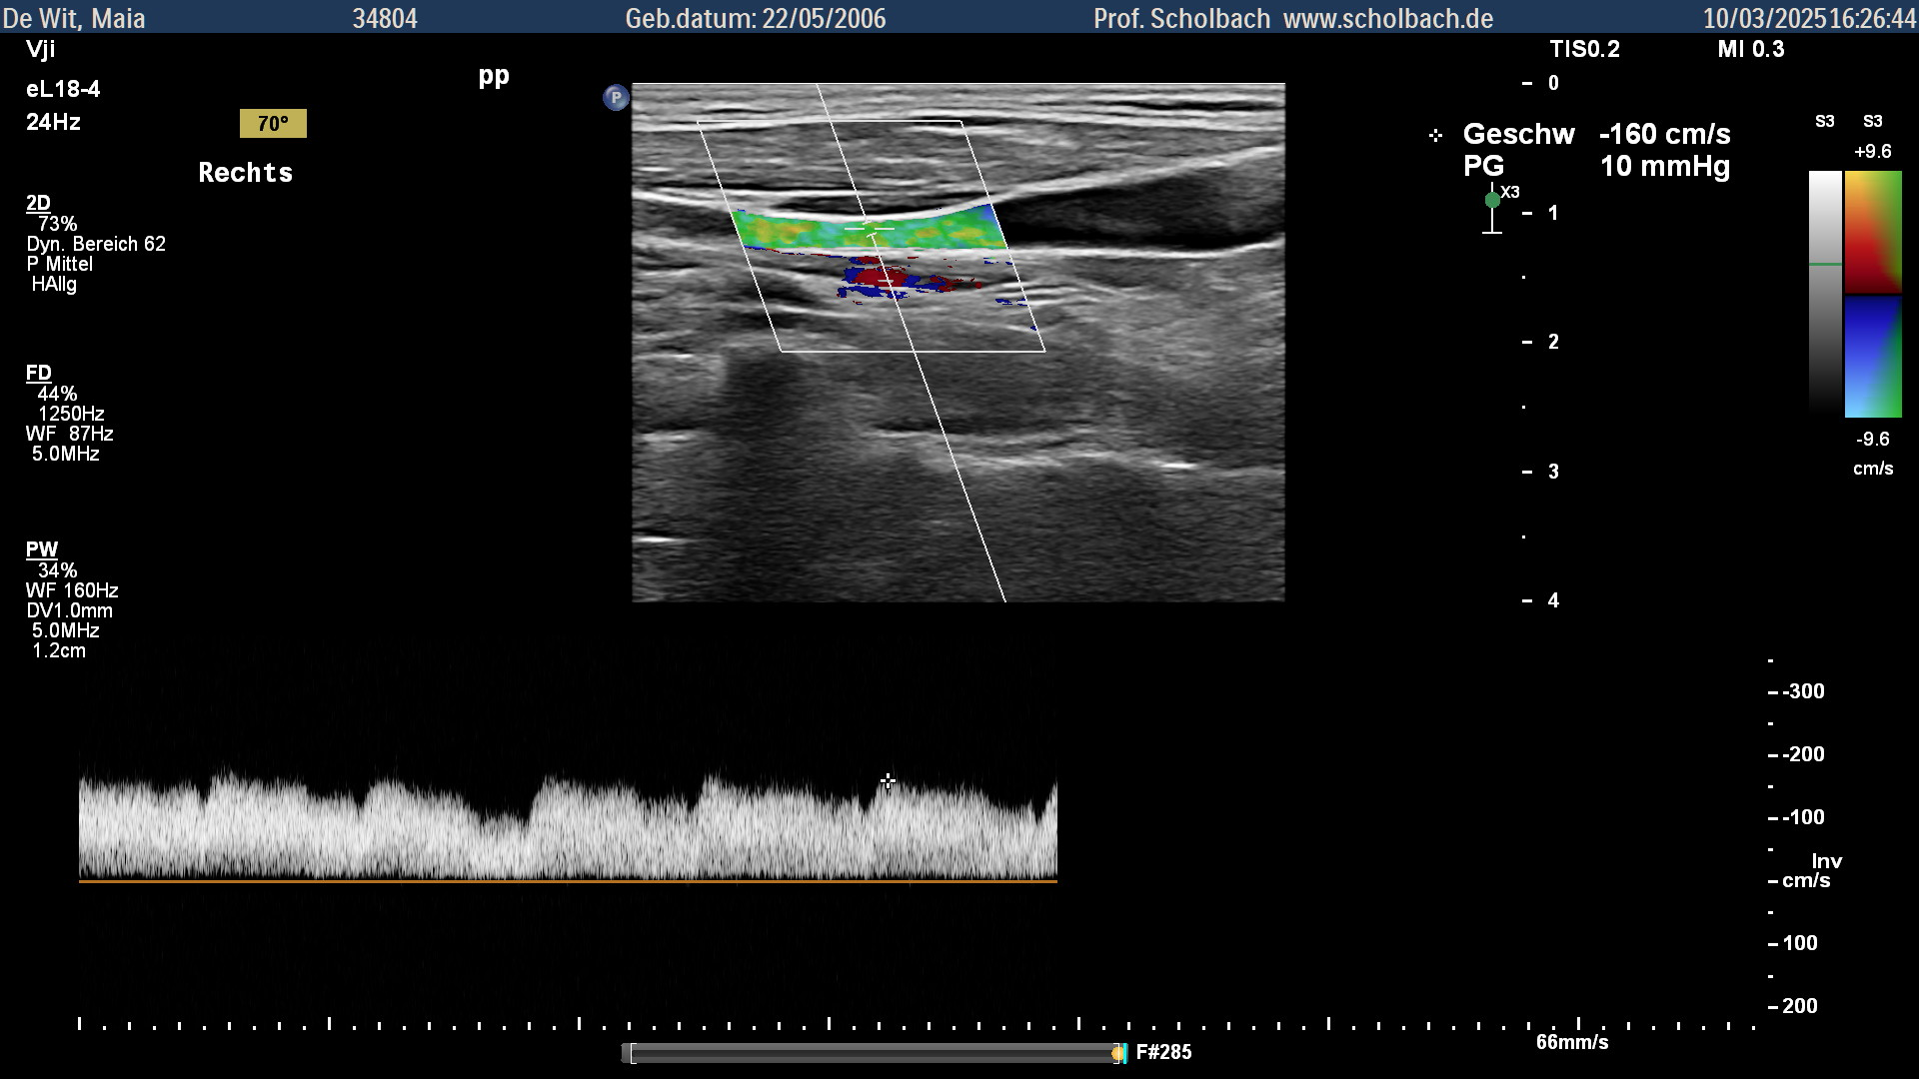
Why 4D-PixelFlux volume flow measurements?
The flow volume matters: Defines oxygen and nutrient supply as well as organ drainage (hormones, metabolites, messengers)
Traditional sonographic methods to measure the flow volume: From circular area and mean flow velocity
Limits: Vessel size determines the ratio of lumen to wall flow - thus changes friction to transport ratio - thus flow profile - a single mean flow velocity is unrealistic
While arteries are mostly around veins are not - no circular area and thus no simple diameter related flow volume
The solution: Pixel-wise flow measurement corrected for spatial angle
Case 1 presentation
Throbbing migraine-like headaches on the left side of the skull
Left internal jugular vein Right internal jugular vein
Sweep across the jugular veins showing a compression on the right but no compatible compression on the left side
4D- PixelFlux flow volume measurements clearly differentiate individual flow volumes in all brain supplying and draining blood vessels
Comparable flow velocities at the crossing of the omohyoid muscle
Styloid compression - invisible on a sweep
No significant flow velocity reduction cranial to the omohyoid
The difference of the venous outflow and the arterial influx can be precisely quantified and constitutes the spinal epidural influx or outflow which for the first time can be precisely quantified with 4D-PixelFlux
4D-recording of both internal jugular veins
Case 2 presentation
The spinal congestion provoked by abdominal venous compression syndromes significantly determines cerebral symptoms when the internal jugular vein is compressed as well. This frequently accompanies abdominal compression syndromes.
In contrast to the relatively little change of the pressure gradient the volume flow dropped by 52% on the right side whereas the flow volume on the left side changed by only -9%
The preoperative measurements in red - the post-operative measurements in blue columns
Traditional evaluation of an internal jugular vein compression would describe the left jugular vein as less compressed than the right one due to the higher flow acceleration at the compression site of the right internal jugular vein
The 4D PixelFlux volume flow comparison before and after decompression of the abdominal veins clearly shows that the left internal jugular vein is primarily insufficient, while the right vein takes the brunt of the epidural influx (red).
After reduction of the spinal congestion as a consequence of two venous decompressions the flow volume on the right side drops by more than 50% (blue).
Notes:
Folie 2: Einleitung, Einschlußkriterien und Methoden, Ergebnisse

Slide 3
4D-PixelFlux volume flow measurement of the brain allow a precise quantification of the inflow and outflow via the cervical vessels.
The difference is the spinal epidural influx or outflow. This can be quantified for the first time with 4D-PixelFlux.
Clinical applications:
Diagnosis of arterial and venous insufficiency as the cause of headaches, migraines, intracranial hypertension and multiple symptoms of cerebral congestion
(disturbed vision,cranial nerve dysfunction)
Notes:
Folie 3: Schlussfolgerung

