Slide 1
Pelvic congestion syndrome - our experiences in 36 years diagnosed thousands of patients with vascular compression syndromes hundreds successfully operated hundreds successfully treated
Thomas Scholbach: Leipzig/Germany
www.scholbach.de

Slide 2
Agenda
Conflict of interest
Thomas Scholbach invented the PixelFlux-technique and his son
Jakob Scholbach, owner of Chameleon-software, wrote the PixelFlux-software
www.chameleon-software.de
Defining pelvic congestion
Causes
Treatment

Slide 3
What is pelvic congestion syndrome?
Pelvic pain and dysfunction of pelvic organs due to increased blood volume in pelvic organs and blood vessels
Reduced drainage
left (right) common iliac vein / vena cava inferior
Increased venous influx
Left gonadal vein, asc. lumbar vein, contralateral internal iliac vein
Diagnosis
Symptoms
Proof of obstruction and/or flooding
Requires measurement of blood volumes by volumetry and tissue perfusion measurement with the PixelFlux technique

Slide 4
How to evaluate pelvic congestion?
B-mode ultrasound: Edema/varicose veins/common iliac vein distension
Colour Doppler ultrasound: Increased venous blood flow in pelvic organs-PixelFlux measurement
Asymmetry of pelvic venous drainage/volumetry
Outflow obstruction:
On the promontory/beneath the right common iliac artery/lordogenetic compression of the vena cava inferior/compression by the right renal artery/diaphragmatic obstruction/
Increased influx: via left gonadal / contralateral internal iliac vein
Orthostatic venous pooling in pelvis and legs

Slide 5
Pelvic congestion is only one colour in a spectrum! Synchronous occurrence of multiple compression syndromes is the rule not the exception
Lordogenetic midline syndrome
Typical sequence of vascular compressions
Left renal vein compression
Left common iliac vein compression
Vena cava inferior compression
Coeliac trunk compression
Duodenal compression
Internal jugular vein compression
Subclavian vein compression
Femoral vein compression
Popliteal vein compression
Cubital vein compression
Splenic vein compression
Superior mesenteric vein compression
Portal vein compression
Hepatic vein compression
Jejunal vein compression
Gastric compression
Insidious development of symptoms starting in puberty
Female preponderance (90% in diagnosed, 84% in our operated cases)
Hypermobility disorders (hypermobile Ehlers-Danlos syndrome)
Flat lower thoracic aperture
Increased lumbar/cervical lordosis
Spinal length- pelvic width - carrying weight
Narrow abdominal cavity
Space reservoir decompensates with
Orthostasis
Food uptake
Certain body postures

Slide 6
Diagnosis
What you need
What you rarely need
Three-dimensional reconstruction of
Venous CTA in 1 mm slices
Compassion
Trust
Knowledge
Experience
Time
Functional quantitative colour Doppler ultrasound
What you can forgo
Psychologist
MRI
Intravascular ultrasound
Transvaginal ultrasound
Diagnostic laparoscopy
Nerve decompression

Slide 7
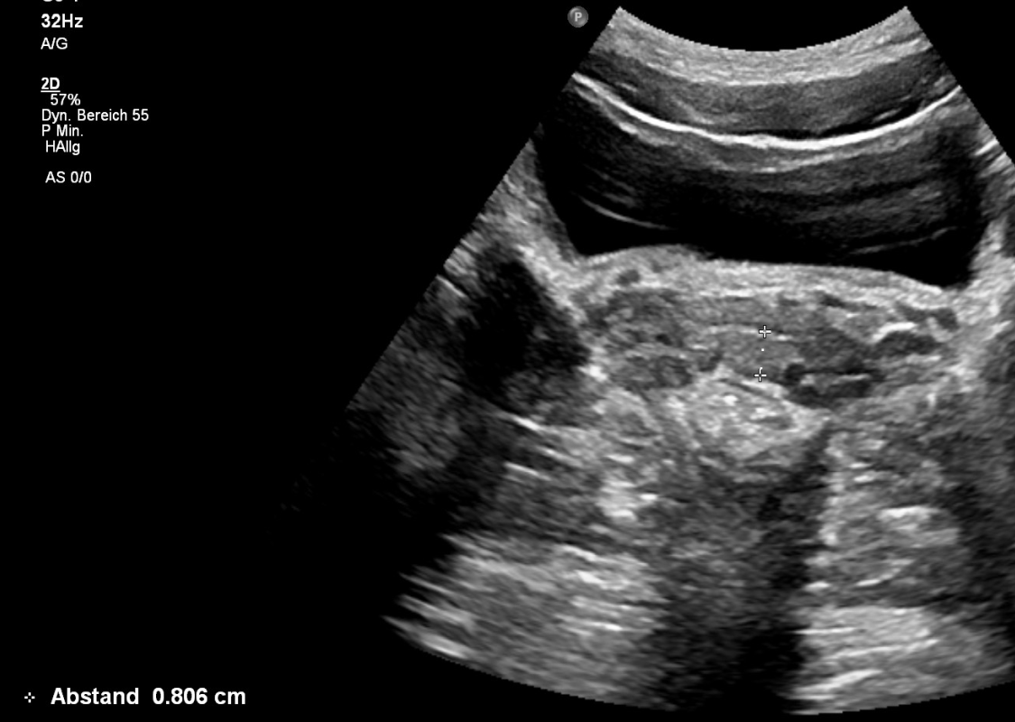
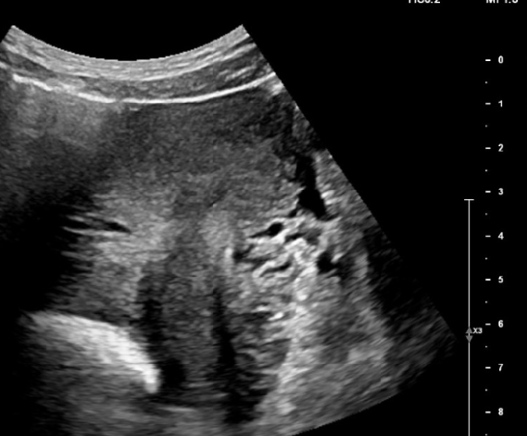
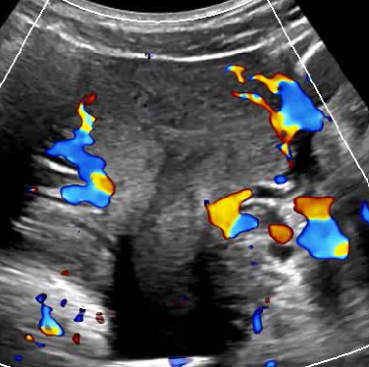
Varicose veins
Maximum wall thickness of the vagina<3 mm

Slide 8
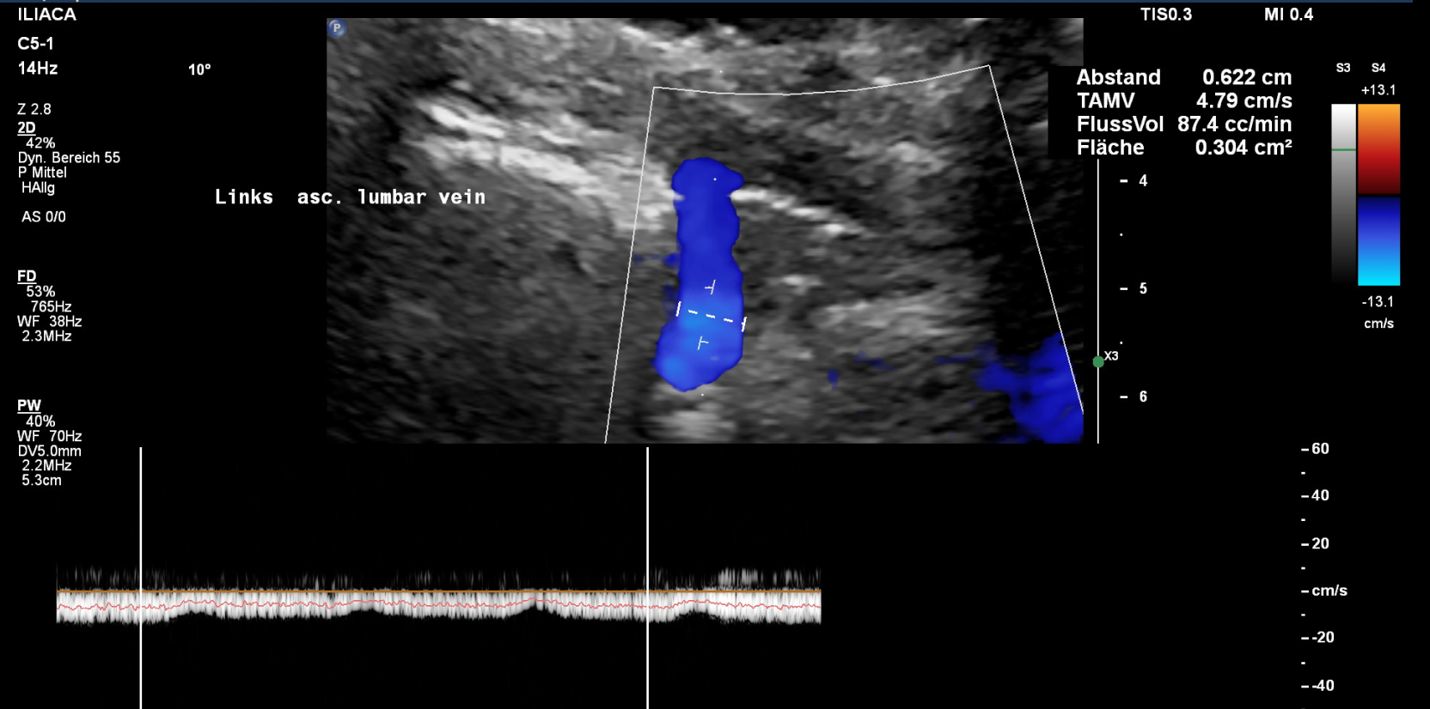
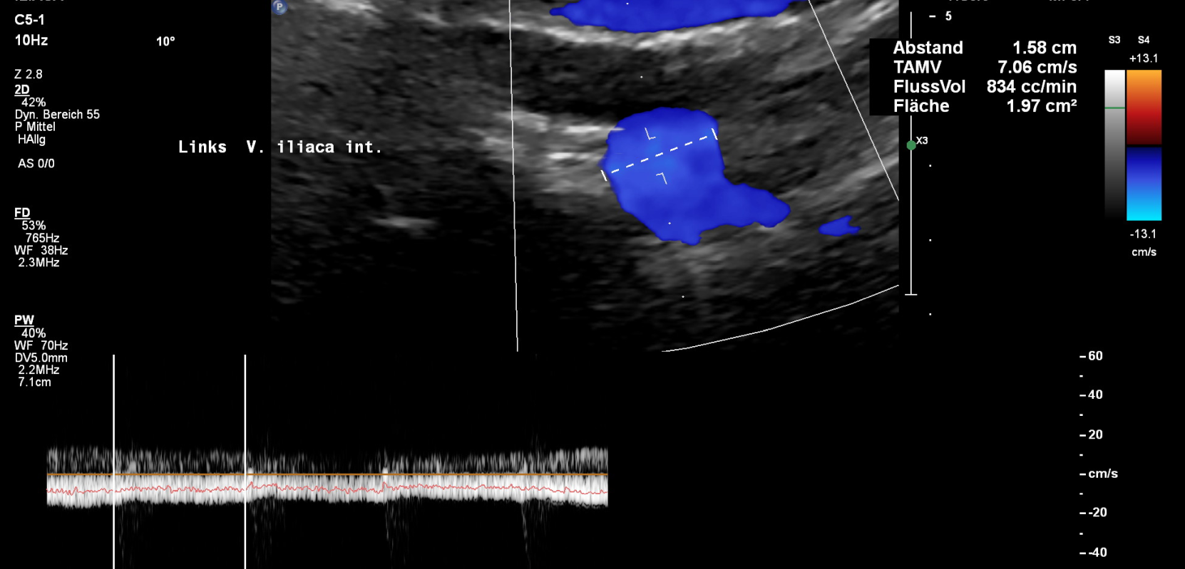
Blood flow volume measurements in the internal iliac veins and collaterals
Cranial flow in the left ascending lumbar vein
Retroverted flow into the left internal iliac vein

Slide 9
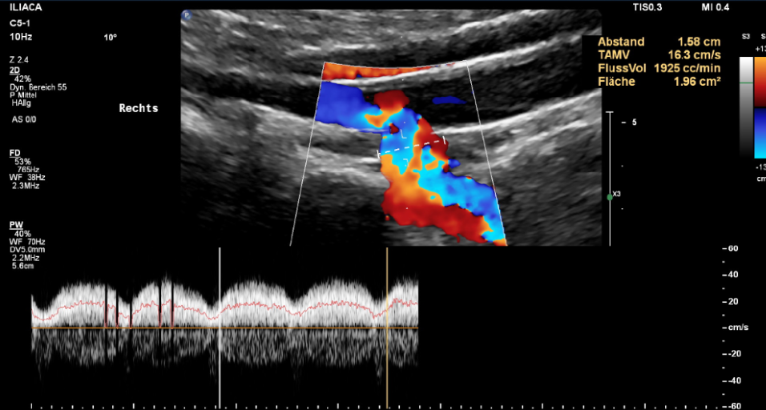
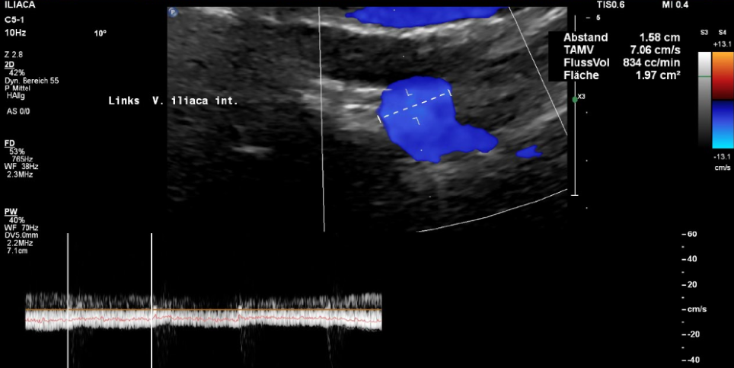
Asymmetry of the venous drainage of the pelvic organs
Blood flow volume measurements in the left and right internal iliac vein
Calculation of the discrepancy
Side | Internal iliac vein flow volume (ml/min) | Share of the left side on the total pelvic drainage volume (%)
Left | -834 | -30 %
Right | 1925 | Normal ~ 50%

Slide 10
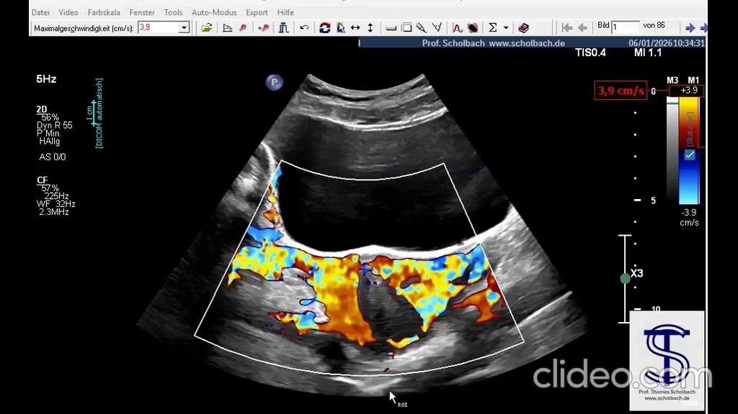
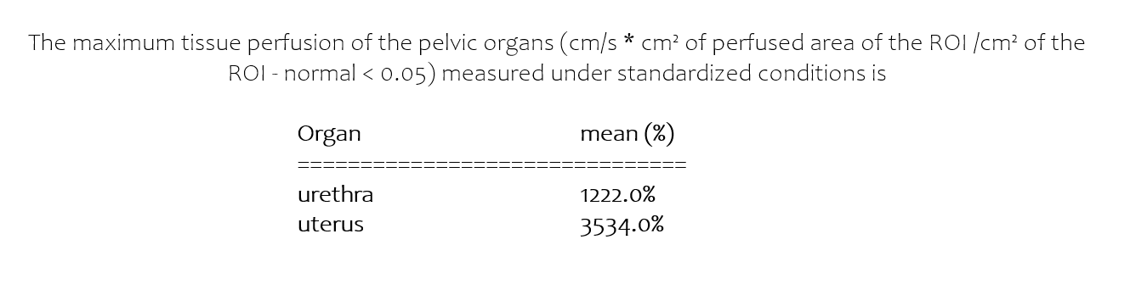
Quantification of the congestion of pelvic organs with the PixelFlux technique

Slide 11
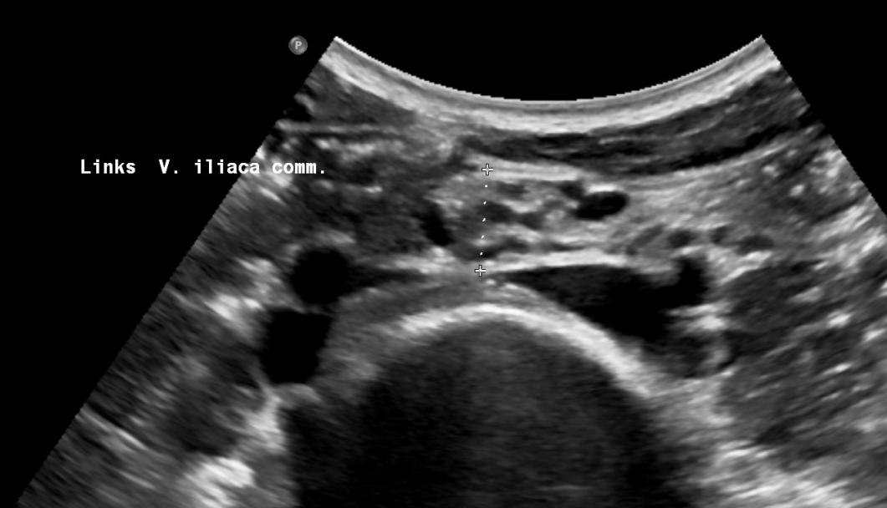
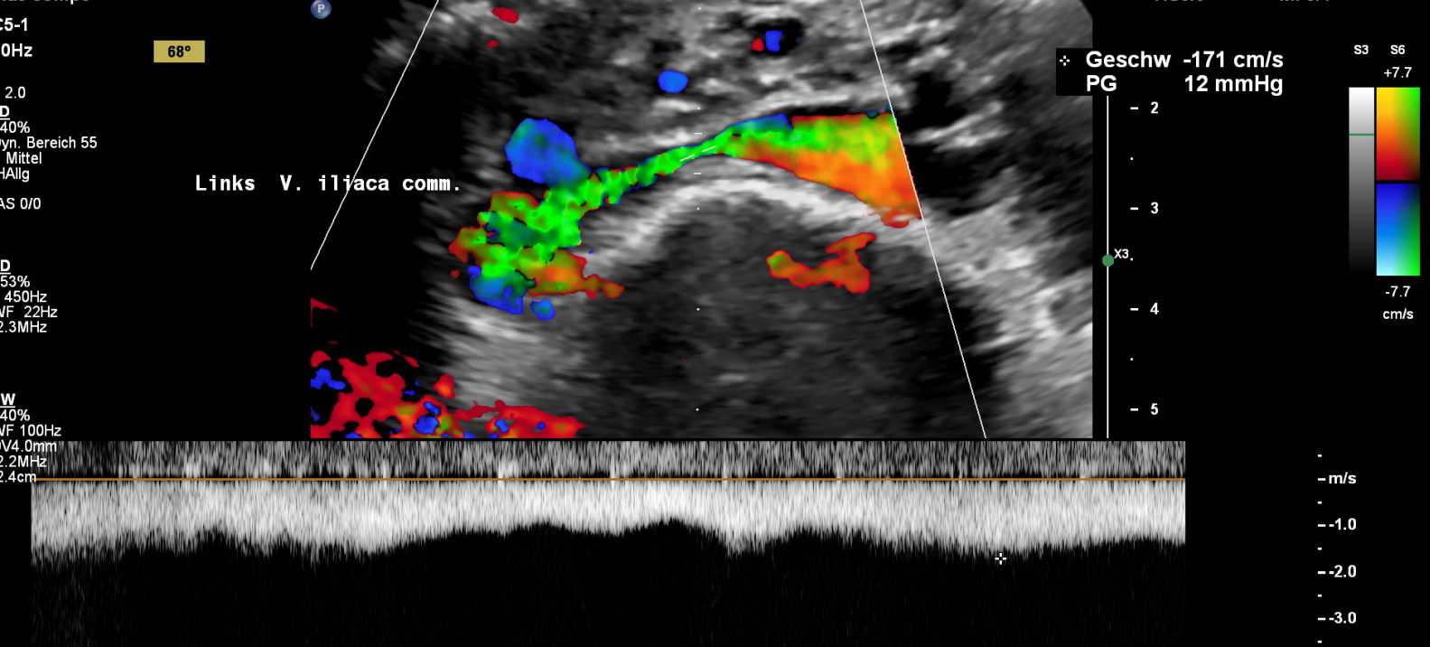
Left common iliac vein compression
Uplifted promontory reducing the abdominal depth
Pressurisation by uplifting –
Maximum compression not always by the right common iliac artery
1,25 cm

Slide 12
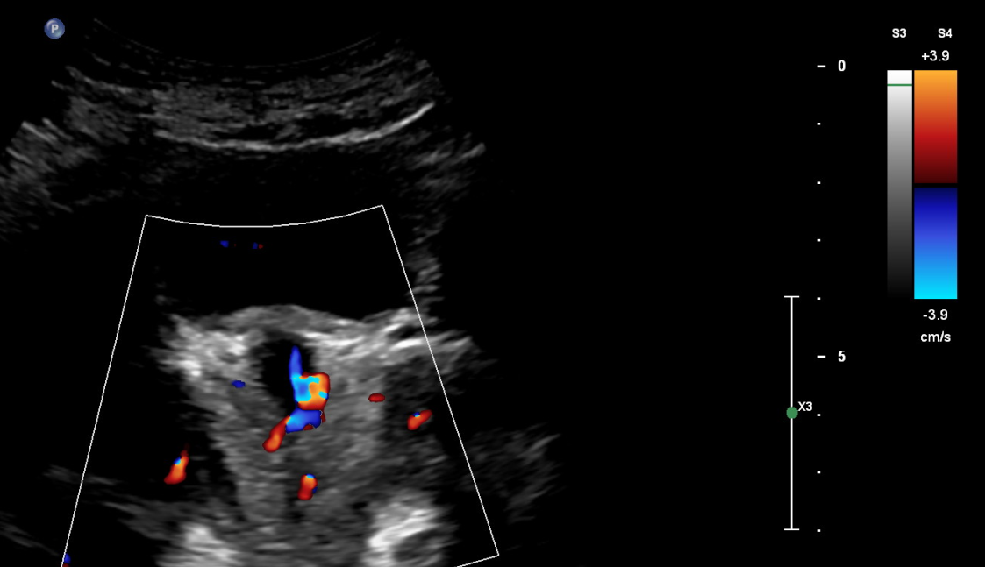
Urethral congestion: residual volume, urgency, frequency, dysuria
Urethral congestion requiring self catheterisation until the decompression of the left common iliac vein
PixelFlux tissue perfusion of the pelvic organs measured under standardised conditions (cm/s * cm² of the perfused area of the ROI /cm² of the ROI – normal < 0.05)
rectum | 0,073 | 146%
urethra | 0,363 | 726%
uterus | 0,534 | 1068%
vagina | 0,204 | 408%

Slide 13
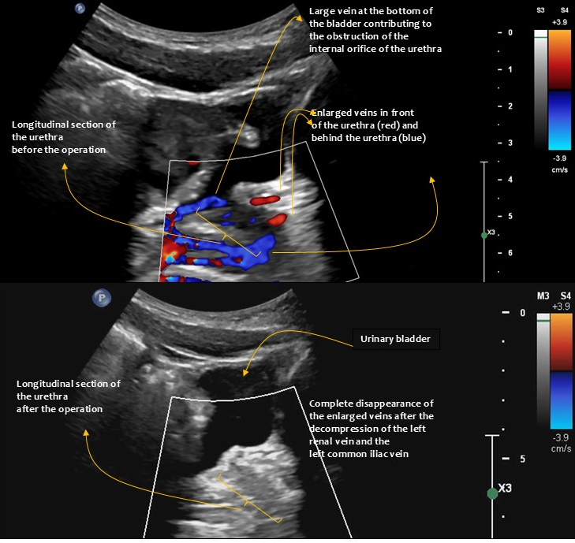
Urethral congestion No more self catheterisation after PTFE-decompression of the left common iliac vein

Slide 14
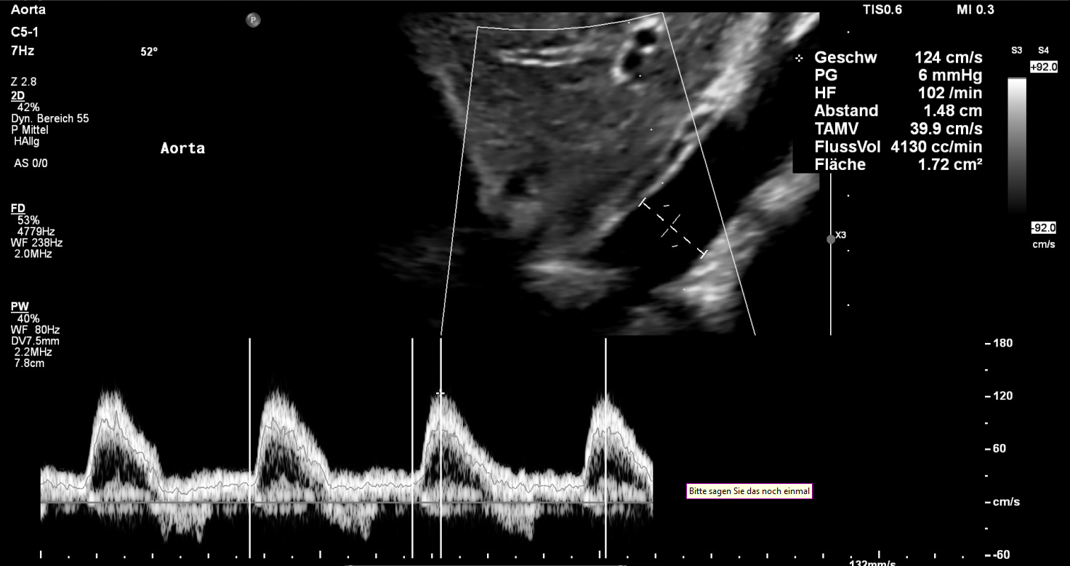
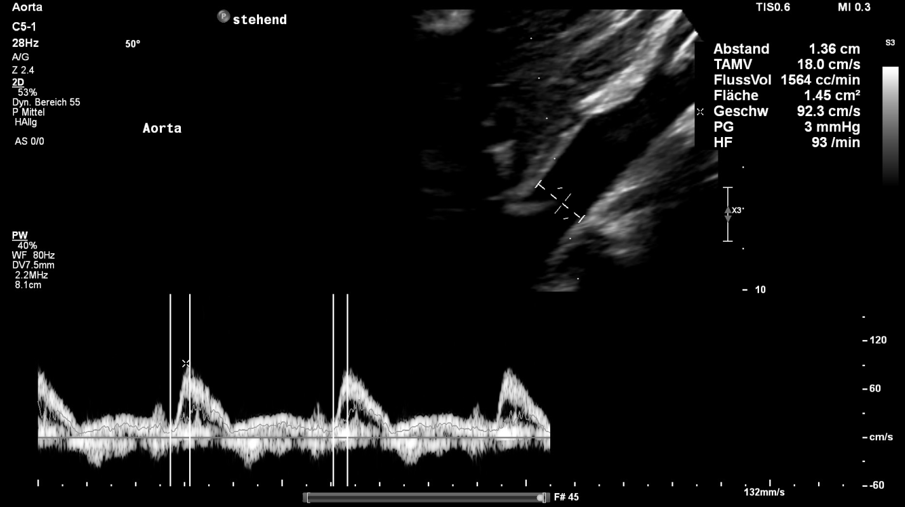
Orthostatic pooling and reflux
Posture | Abd. aortic flow volume (ml/min | Heart rate ( 1/min) | Systol. flow velocity ( cm/s) | Abd. Portion left ventricular ejection (ml)
horizontal | 4130 | 120 | 124 | 40
upright | 1564 | 93 | 93 | 17
Orthostatic difference (%) | -62% | -9% | -25% | -58%

Slide 15
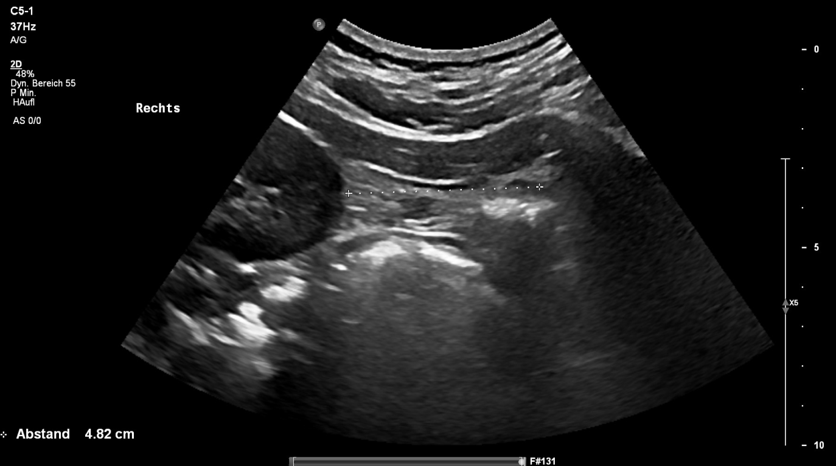
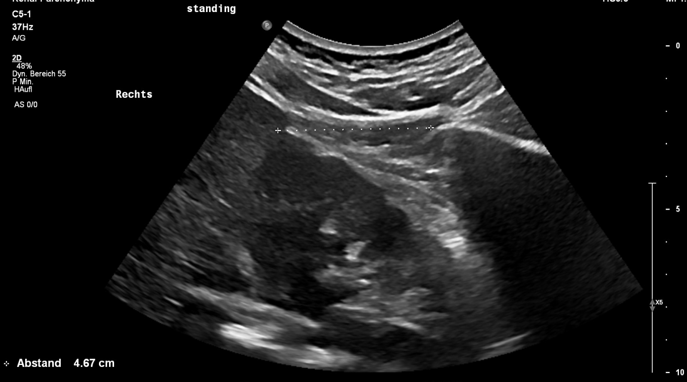
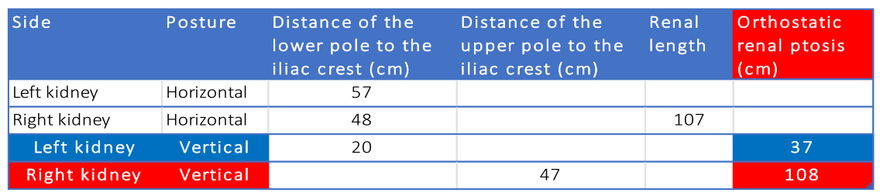
Functionally relevant orthostatic nephroptosis:
drives pelvic congestion due to reduced renal blood uptake
is successfully treated with nephropexy

Slide 16
Treatment
What you should avoid
What you need to do
Reduction of the collaterals
Embolization
Coiling
Ligation
Hysterectomy
Stents
Reduce spinal curvature
Foster collaterals
Decompress venous obstructions

Slide 18
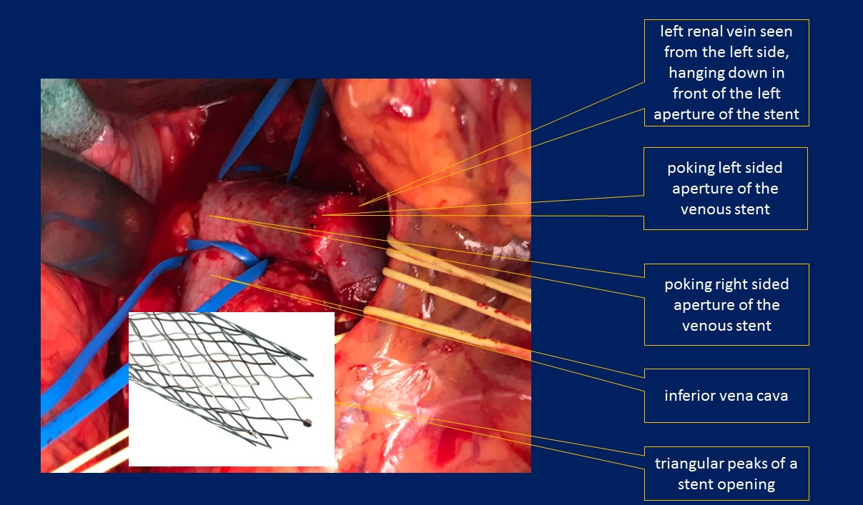
What a stent may look like
https://scholbach.de/de/risiken-venoeser-stents

Slide 19
Non-invasive treatment
Reduction of the lumbar lordosis
Fostering of collateral pathways
Daily physical training
Planks
Prone trunk elevation
Pelvic tilt control
Flexing hips
Contraction of gluteal and abdominal muscles
Weight reduction
Squats
Aspirin and physical ecercises

Slide 20
Surgical treatment “Nihil nocere!”
Do not harm the vein
Reconstruct venous return
No stent
No embolization
No bypass
No patch
Ring enforced PTFE shield covering the compressed portion of the vein
Left common iliac vein and left renal vein
Nephropexy if orthostatic nephroptosis is haemodynamically relevant (PixelFlux)
Treat all other compression simultaneously

