Slide 1
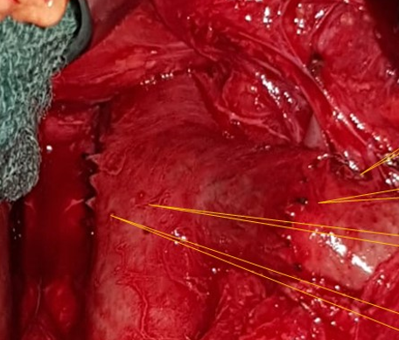
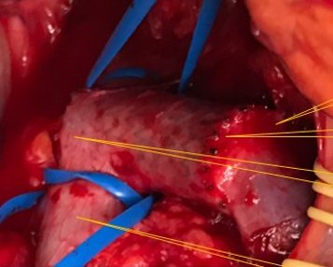
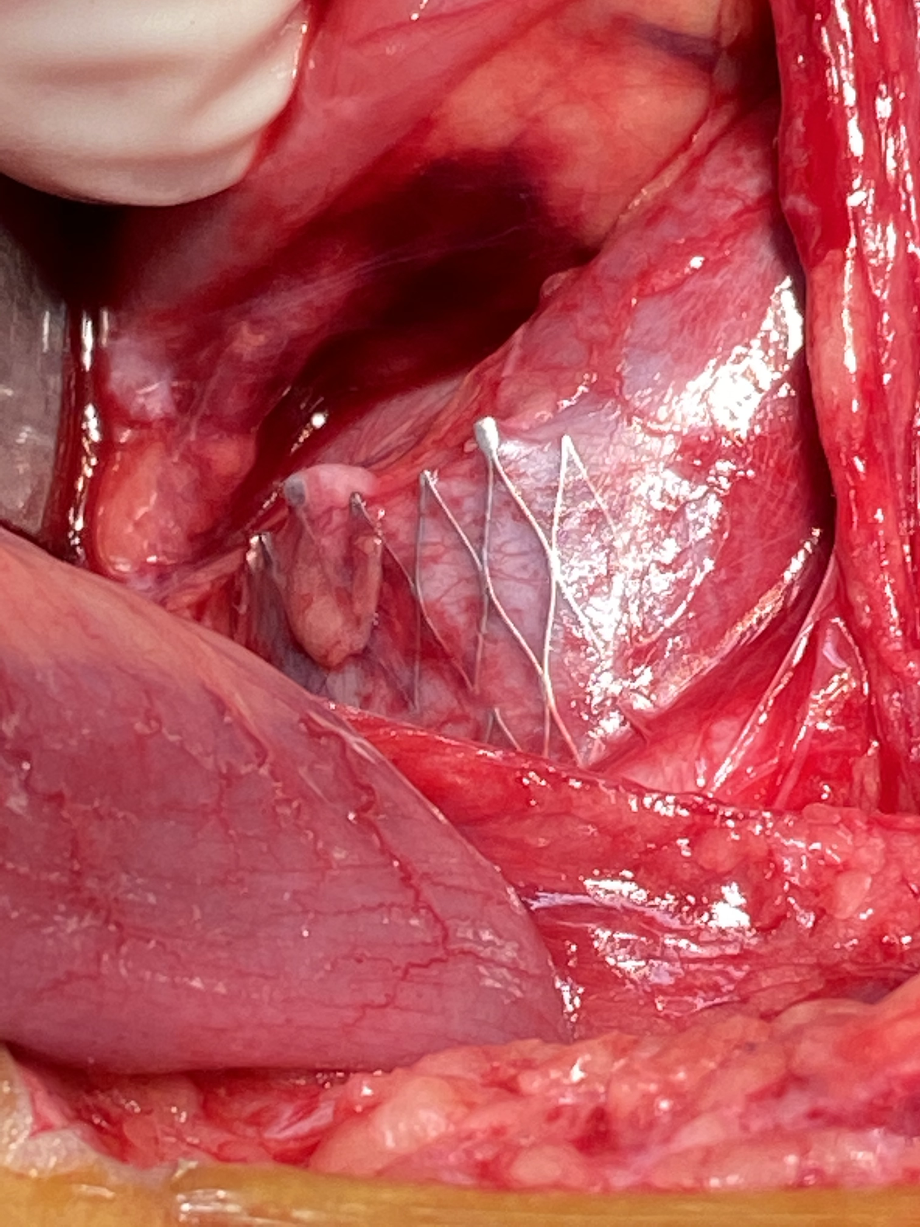
Venous stenting of abdominal compression syndromes (ACS)- basically not a good idea
T. Scholbach¹, W. Sandmann^{1, 2}
1. Functional Ultrasound Practice, Leipzig, Germany
2. Clinic Bel Etage, Vascular Surgery, Düsseldorf, Germany
Talk presented at the Annual Meeting of the German Angiological Society
21.09.-23.09.2023 in Leipzig, Germany

Slide 2
53 Patients 05/2017 -12/2022 after stenting with abdominal compression syndromes
Sum of examined vascular compression patients: 946 exams in 813 patients
53 stented patients = 6,5%
52 female / 1 male
Hypermobile Ehlers –Danlos-Syndrome
Functional volumetric PIXELFLUX Doppler examination
Interval to stenting : 20 m (1-146m)
98%
Vessel stented | Patients (n) | Stents (n)
left common iliac vein | 33 | 33
left renal vein | 16 | 21
coeliac trunk | 5 | 5
right common iliac vein | 1 | 1
right femoral vein | 1 | 1
superior mesenteric artery | 1 | 1

Slide 3
Despite initial patency of the stent at the former compression site
Common delusion: „It‘s all in your head!“

Slide 4
Why stents often fail
too hard
lordotic U-turn vein vs. straight stent
too soft
Collapse (sometimes only while standing)
too rigid
Wall penetration
Angle with the vein
other compressions neglected or missed
Venous stretching by uplifting
Conflict with neighbouring organs: arteries, bowel..
Stent force
Stent force
4
VCI
3
5
Venous traction
Stents need to be hard and soft at the same time - contradiction in terms

Slide 5
Causes of functional stent failure
Curtain effect
Rebound effect
Springboard effect
Collapse of the stent
Wall penetration
Displacement
Dysfunction of an open iliac stent due to missing a coexisting left renal vein compression
Stent increasing other vascular compression
Stent producing a new vascular compression
Travelling stent produces new compression
Seesaw effect
Angulation of 2 overlapping stents
Posture dependent narrowing or collapse - -
+ Overlooking or neglecting concomitant vascular compressions

Slide 7
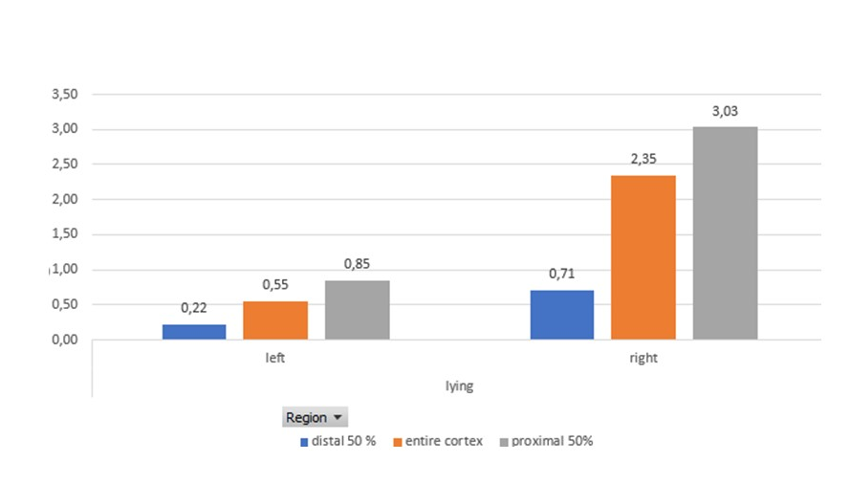
Renmal parenchymal perfusion with the PixelFlux technique
PixelFlux measurements clearly show that the stent is not functioning properly despite opening of the primary left renal vein compression. Blood flow in the left kidney is only 23% of right blood flow, resulting in severe renal pelvic congestion.

Slide 8
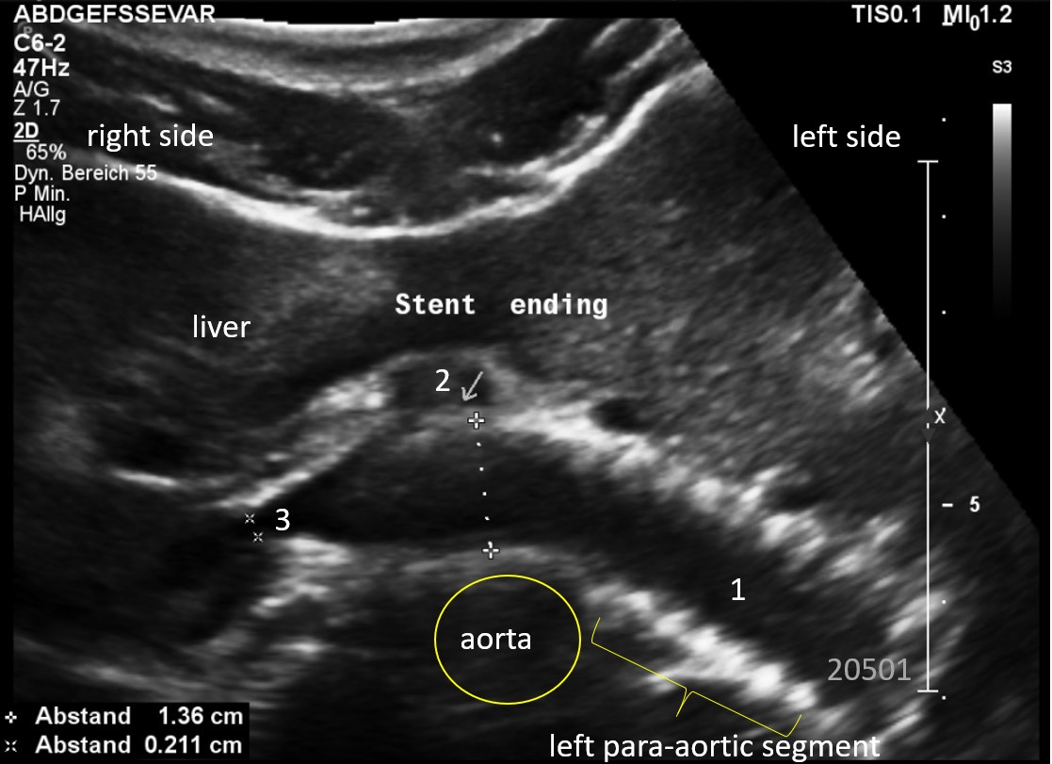
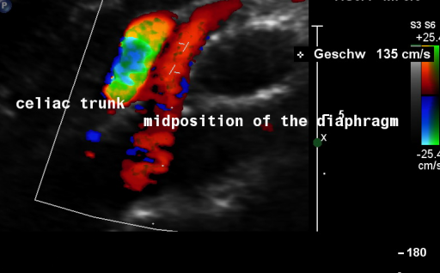
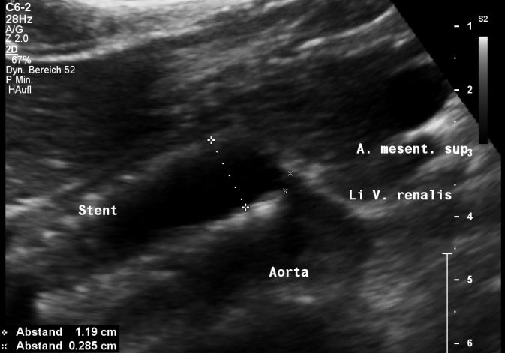
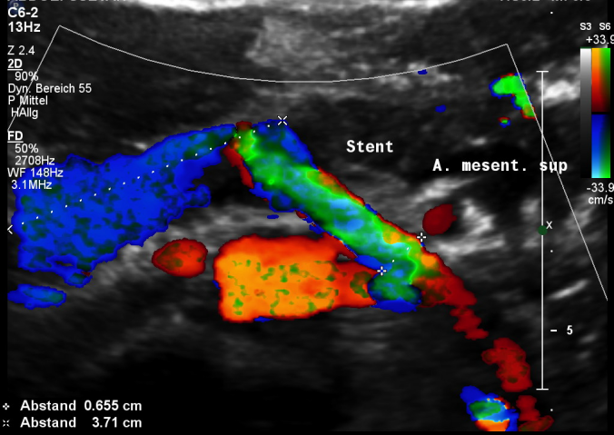

Slide 9
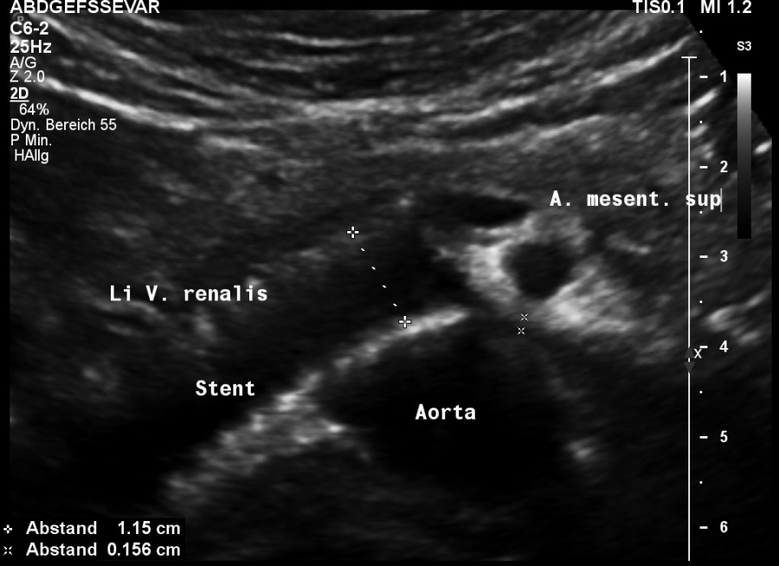
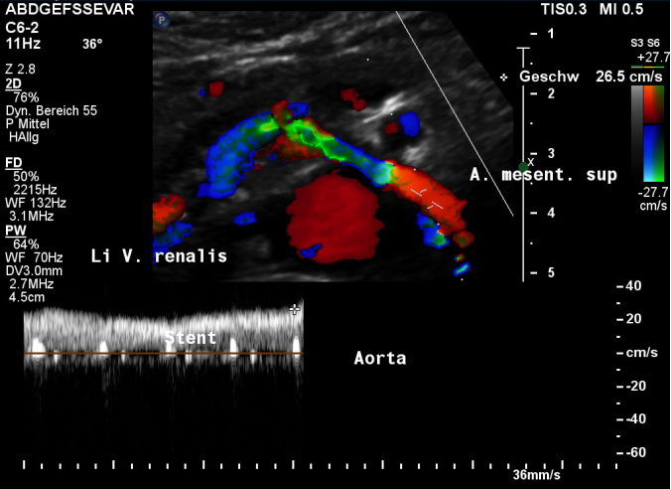
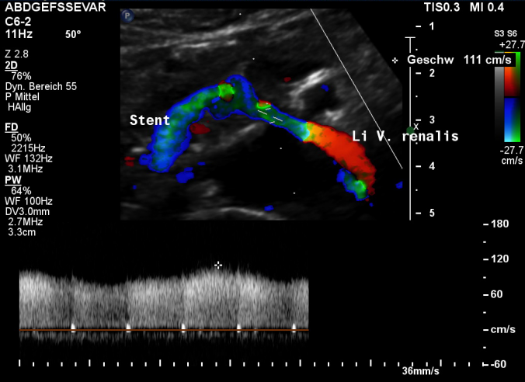
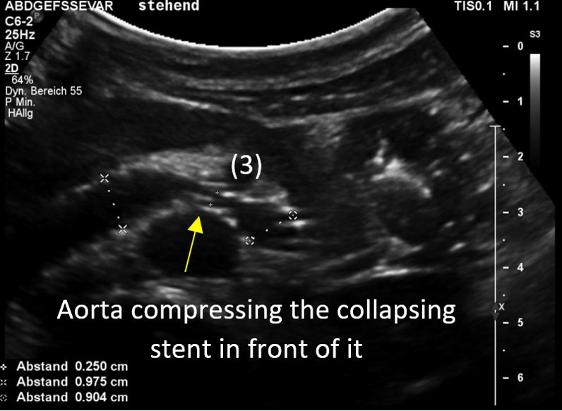
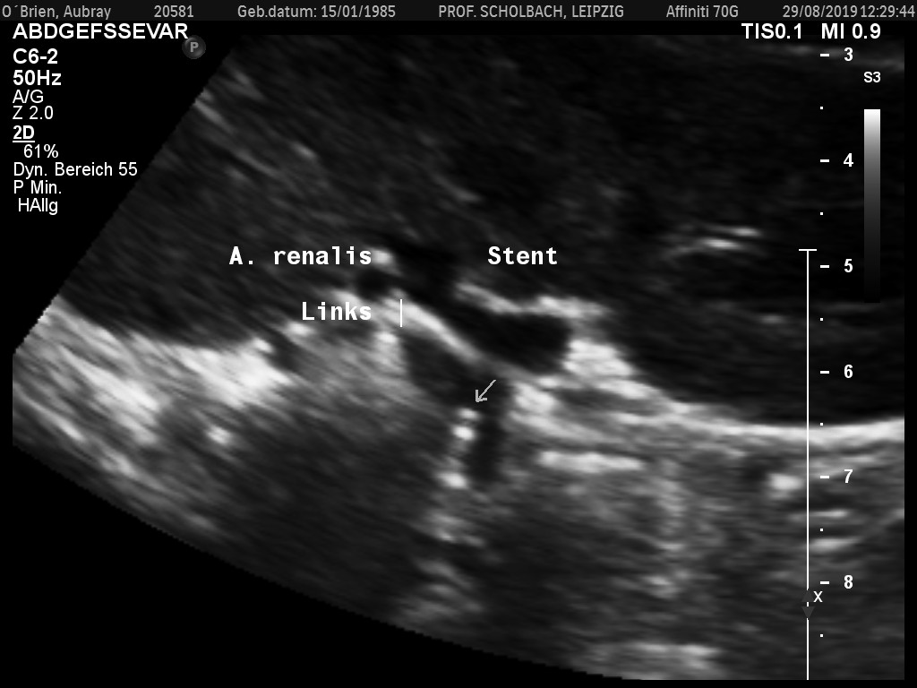

Slide 10
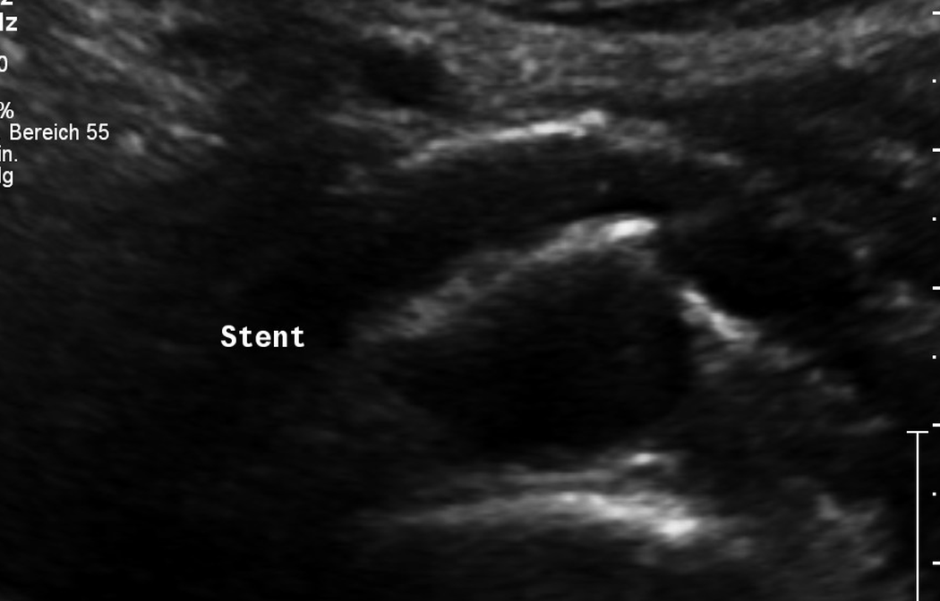
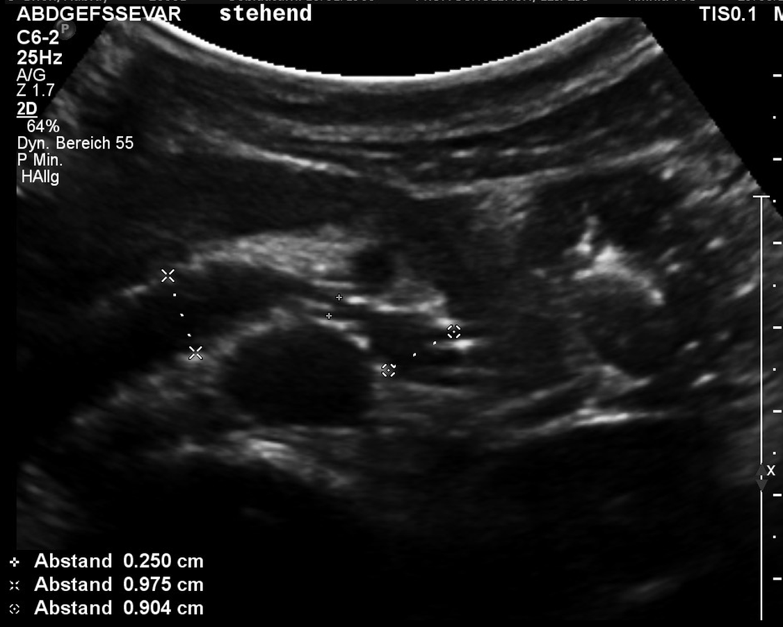
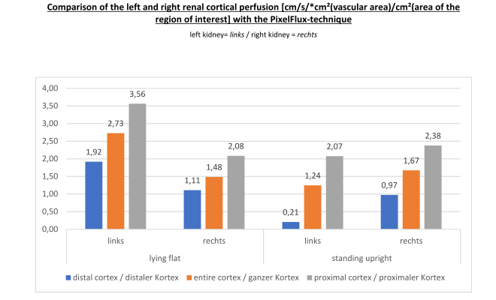
Notes:
20581 0829

Slide 11
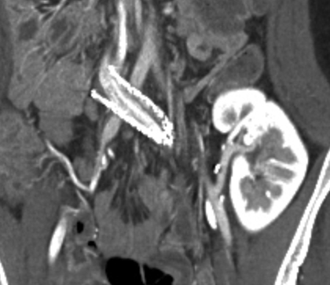
Poking stent

Slide 14
using

Slide 17
Conclusion
Hands off stents
in abdominal vascular compression syndromes

