Slide 1
The lordogenetic midline syndrome - pathophysiology, diagnosis and treatment of abdominal vascular compression syndromes
T. Scholbach¹, W. Sandmann^{1, 2}
1. Functional Ultrasound Practice, Leipzig, Germany
2. Clinic Bel Etage, Vascular Surgery, Düsseldorf, Germany
Talk presented at the Annual Meeting of the German Angiological Society
21.09.-23.09.2023 in Leipzig, Germany

Slide 2
Disclosure
Thomas Scholbach and his son Jakob Scholbach
have developed the PixelFlux-software

Slide 3
33 years observation – thousands of patients
High prevalence in undiagnosed „psychosomatic“ pain patients
Female – hyperflexible – tall
Potpourri of symptoms
Thoracic - epigastric – left flank – deep pelvic - leg pain
Swelling (lower abdomen – legs)
Vegetative symptoms: nausea, vomiting, postural tachcardia, fainting
Neuro- symptoms: numbness, weakness, paralysis, bladder and bowel issues
Multiple compressions occur together
You cannot properly evaluate them without functional testing
Gravitation – Digestion – Micturation –
Blood flow quantification
PIXELFLUX - European Ultrasound Award 2015

Slide 4
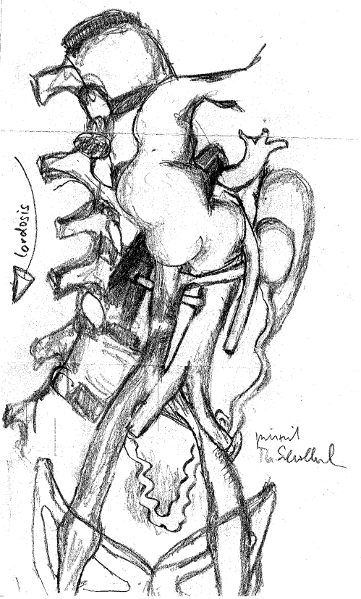
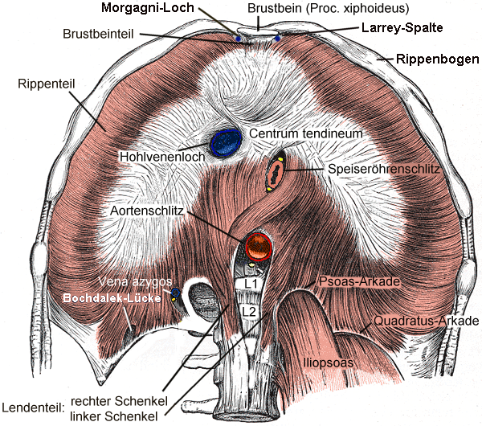
All abdominal compression syndromes are consequences of a strong lumbar lordosis
Nutcracker syndrome
Celiac artery compression syndrome
May-Thurner-syndrome
Superior mesenteric artery syndrome
Compression of the inferior vena cava
Pelvic congestion syndrome
Midline congestion syndrome
Lumbar artery compression
Compression of the femoral veins
2
4
1
8
5
3
9
6

Slide 5
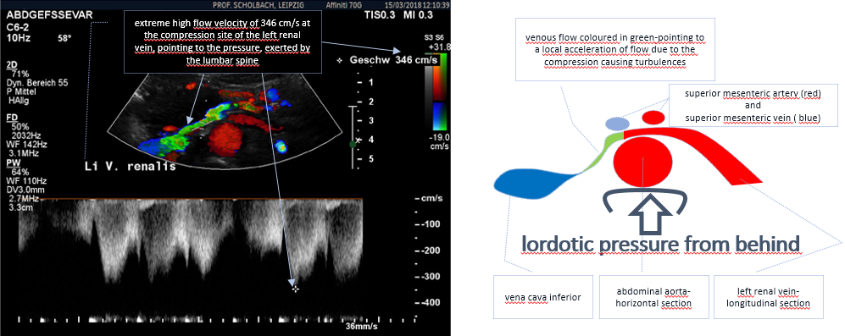
Nutcracker syndrome –stretched hips

Slide 6
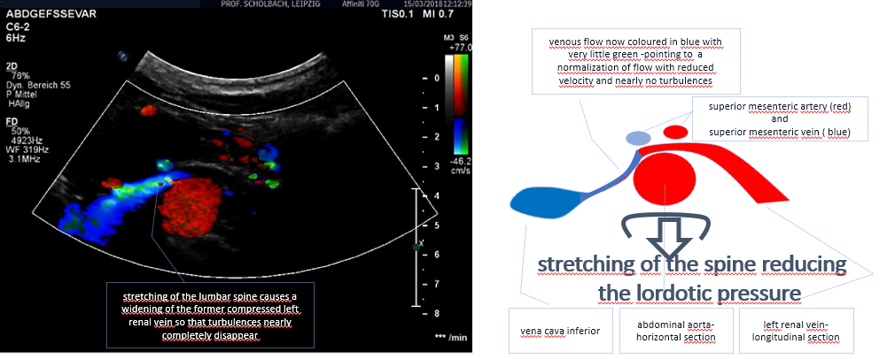
Nutcracker syndrome –flexed hips
Hip flexion induces kyphosis – flow velocity drops dramatically
from 346 to 50 cm/s, left renal vein compression disappears
No turbulences anymore

Slide 7
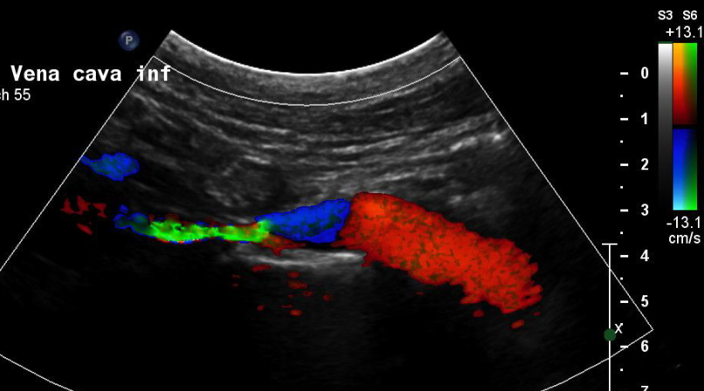
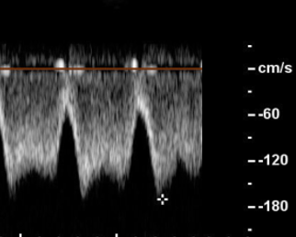
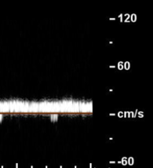
Compression of the inferior vena cava
170 cm/s
20 cm/s
Active flexion of the lumbar spine

Slide 8
Left renal perfusion (shown below [cm/s/cm²]) is directly dependent on the degree of lumbar lordosis: less lordosis– less venous pressure – better small vessel perfusion- higher overall perfusion
Distal to entire cortex ratio
0,17 0,47 0,68
Lordosis = venous pressure = small vessel hypoperfusion
Notes:
Bi. Li. 29.05.2017

Slide 9
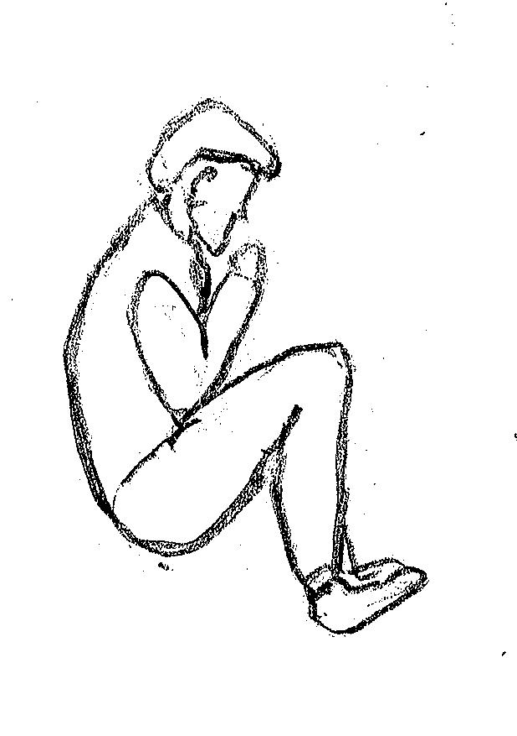
Superior mesenteric artery syndrome
11 mm
6 mm
Vena cava
Vena cava
spine
spine
Lordosis: supine position, strechted hips
Kyphosis : left side position, flexed hips

Slide 10
134 operated patients with abdominal compression syndromes 7/2019 - 08/ 2023

Slide 11
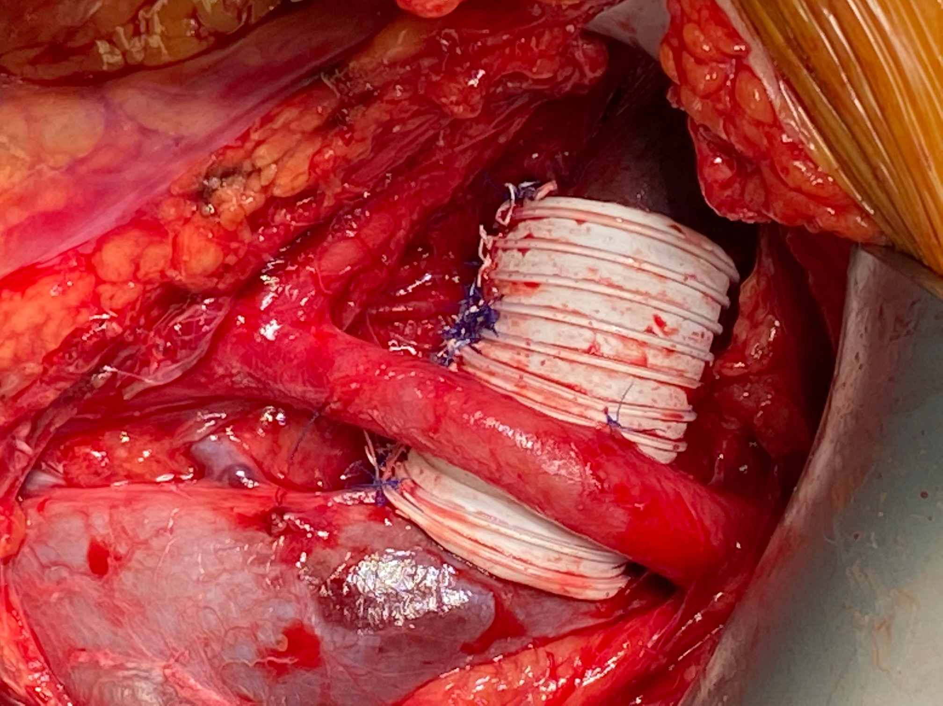
PTFE wrapping and MALS resection
External PTFE –wrapping
of the left renal vein and the left common iliac vein
MALS resection

Slide 12
Treatment results
Successful decompression - n = 129
Recurrent compression - n =2
Residual compression - n =2
Remaining compression - n =1
No death, no infection, no thrombosis
3 reconstructions – extensions
No removals

Slide 13
Long term treatment results of 196 adult and 58 pediatric cases 2005 - 2020
90.5% of SMAS-patients pain-free eating and weight gain within 6 months post SMA – TX
98 % amenorrhea resolved in 2 years
95 % adult MALS-patients significantly improved within 3 m
93 % (54/58) pediatric MALS patients - symptom free 62 m postop

Slide 14
Important practical consequences
Abdominal vascular compression syndromes are not separate diseases but parts of a spectrum of one entity – the lordogenetic midline congestion syndrome and thus often occur together
Quantitative functional color Doppler Ultrasound is necessary for a comprehensive understanding
The pittoresque symptomatology is not a psychologic dramatization by the patient but the consequence of venous congestion of many organs – from toe to brain
Connective tissue disorders predispose to vascular compressions
Disease progression and expansion is the rule
The patient does not need a psychiatrist but a surgeon to treat her successfully

